Slide 1
ER MODELLING FOR GAME DEVELOPMENT Session 19&20
Course : ISYS6280 – Database Systems (GAT)
Year : 2017

Slide 2
LEARNING OUTCOME
LO 3: Design database using Object Oriented data model

Slide 3
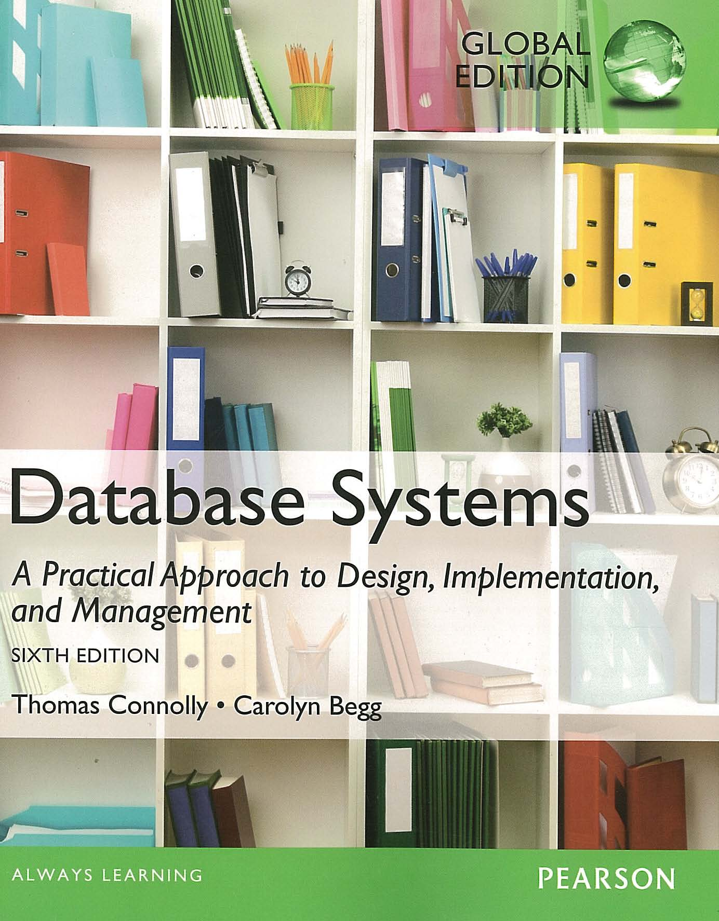
ACKNOWLEDGEMENT
These slides have been adapted from Thomas Connolly and Carolyn Begg. 2015. Database Systems: A Practical Approach To Design, Implementation, and Management. Pearson Education. USA. ISBN:978-1-292-06118-4

Slide 4

Learning Objectives
Able to explain about :
The Concept of ER Modeling
Object-Relational DBMS
Semi Structured Data
XML Schema and Query Language
vtraining-msuhandi.blogspot.com

Slide 5
CHAPTER 12 THE CONCEPT OF ER MODELLING

Slide 6
4 Components in ER-Modeling
Entity/ Entity Type
Relationship
Attribute
Multiplicity
Customer
Order
custID
orderID
custName
1
0..*
orderDate
address
amount
email

Slide 7
Entity is a group of objects with the same properties, which are identified by the enterprise as having an independent existence.
A uniquely identifiable object of an entity is referred as an entity occurrence
Customer
Order
Product
Places
Consists of
Relationship is a set of meaningful associations among entities
Notes:
A uniquely identifiable object of an entity is referred as an entity occurrence

Slide 8
3 Types of Relationship
Binary Association
Customer
Order
Places
Customer places order

Slide 9
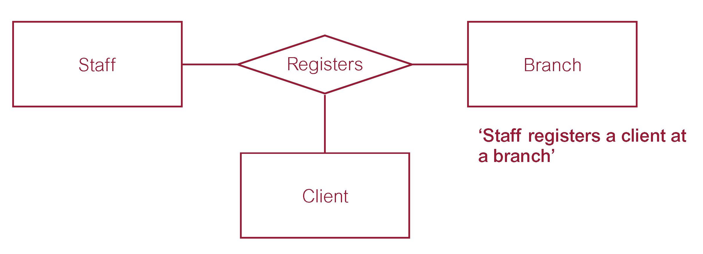
Ternary relationship called Registers
Notes:
An Example of a ternary relationship is register. This relationship represents the registration of a client by a member of staff at a branch. The term “complex relationship’ is used to describe relationships with degrees higher than binary.

Slide 10
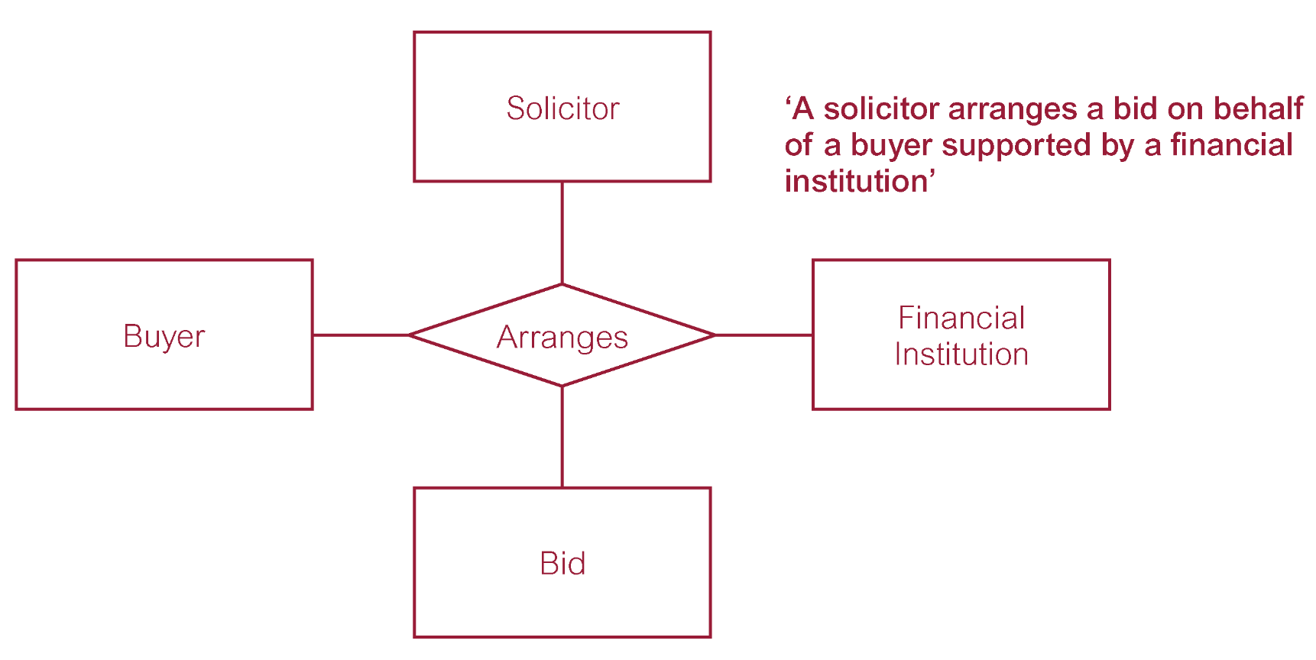
Quaternary relationship called Arranges

Slide 11
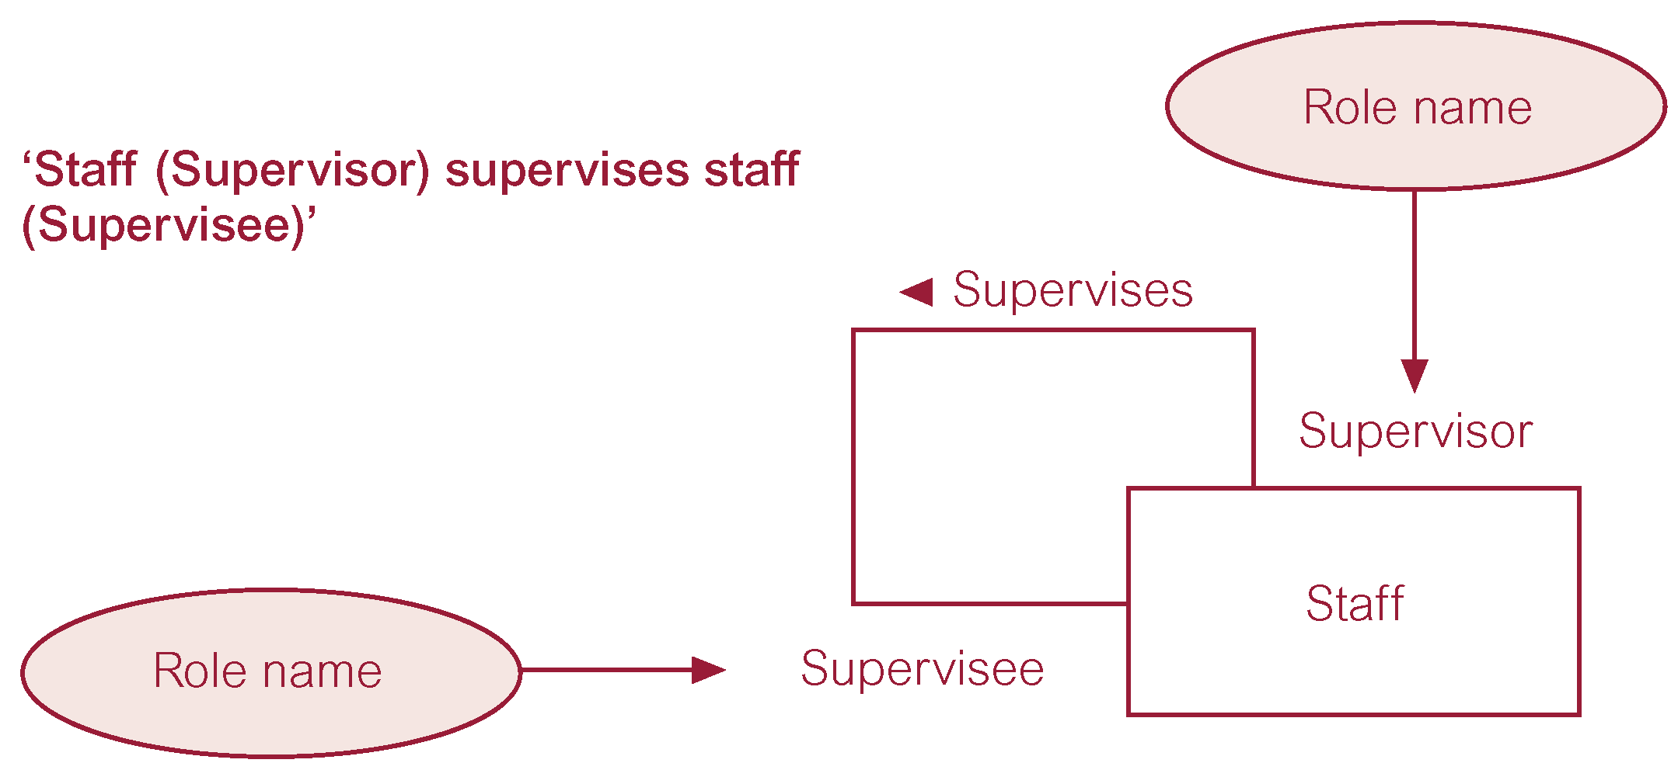
Recursive relationship called Supervises with role names
Relationship type where same entity type participates more than once in different roles.

Slide 12
Attributes
Attribute
Property of an entity or a relationship type.
Attribute Domain
Set of allowable values for one or more attributes.
Customer
custID {PK}
custName
address
Attribute and Attribute Domain
street
city
telNo [1..3]
email

Slide 13
Types of Attributes
Simple Attribute
Attribute composed of a single component with an independent existence
Composite Attribute
Attribute composed of multiple components, each with an independent existence.
Single-valued Attribute
Attribute that holds a single value for each occurrence of an entity type.
Multi-valued Attribute
Derived Attribute
Attribute that represents a value that is derivable from value of a related attribute, or set of attributes, not necessarily in the same entity type.
Attribute that holds multiple values for each occurrence of an entity type.

Slide 14

Keys
addriana1.wordpress.com
Candidate Key
Minimal set of attributes that uniquely identifies each occurrence of an entity type.
Primary Key
Candidate key selected to uniquely identify each occurrence of an entity type.
Composite Key
A candidate key that consists of two or more attributes.

Slide 15
Attributes and Key from Customer, Order, and Product
Primary Key
Customer
Order
Product
custID {PK}
Consist of
custName
Places
orderID {PK}
productID {PK}
address
orderDate
productName
street
custID
price
city
amount
availability
telNo [1..3]
email
Simple Attribute
Composite Attribute
Single and Multi-valued Attribute

Slide 16
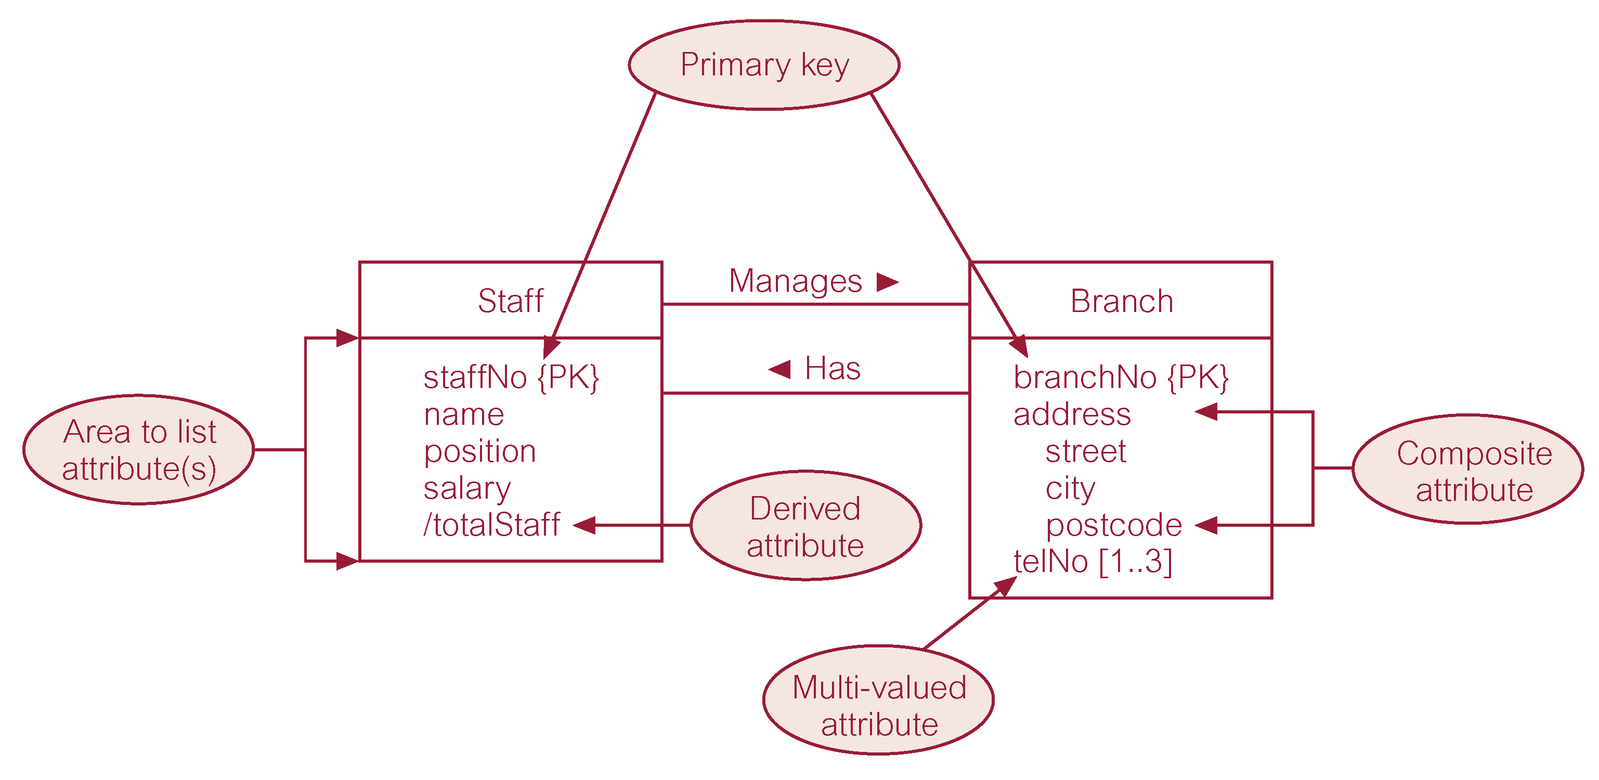
Attributes and Key from Dreamhome Case : Staff and Brach

Slide 17
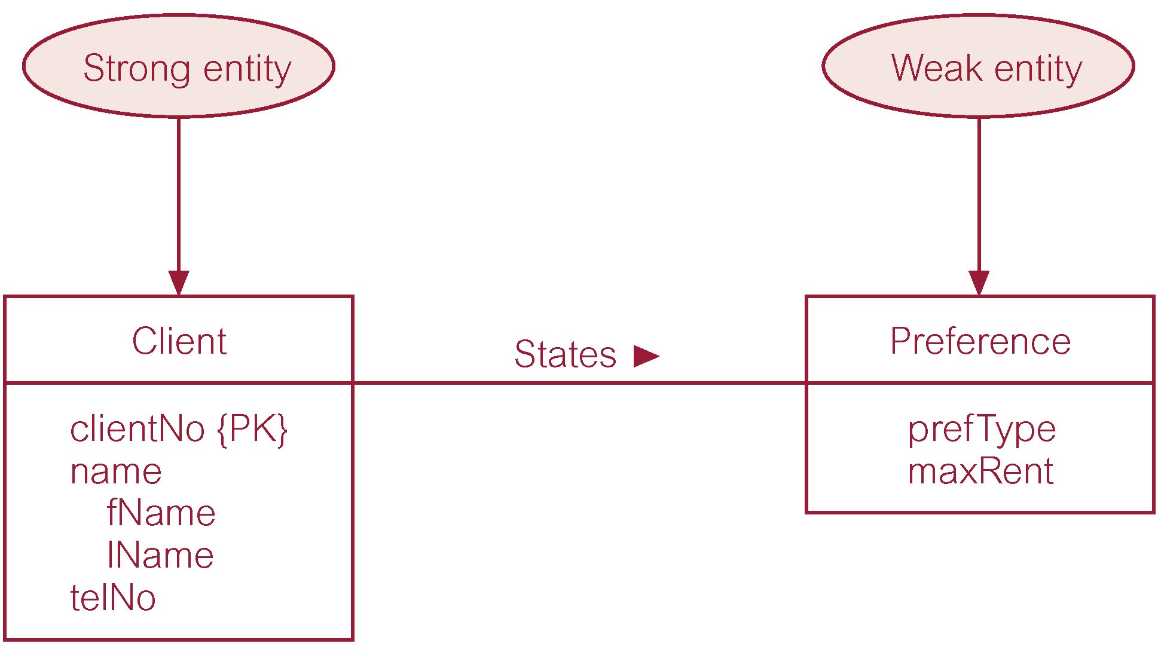
Strong vs Weak Entity
Entity that is not existence-dependent on some other entity.
Entity that is existence-dependent on some other entity

Slide 18
Multiplicity
Main type of constraint on relationships is called multiplicity.
Multiplicity - number (or range) of possible occurrences of an entity type that may relate to a single occurrence of an associated entity type through a particular relationship.
Represents policies (called business rules) established by user or company.

Slide 19
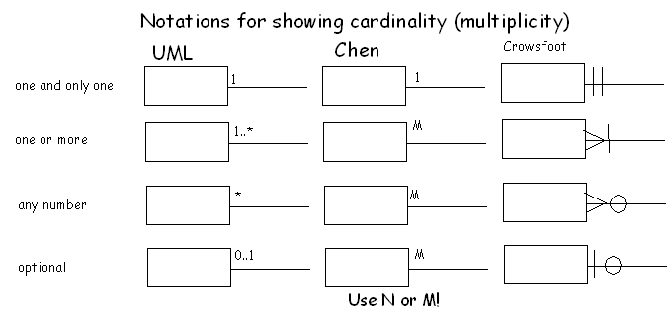
Multiplicity
Multiplicity is number of possible occurrences of an entity type that may relate to a single occurrence of an associated entity through a particular relationship

Slide 20
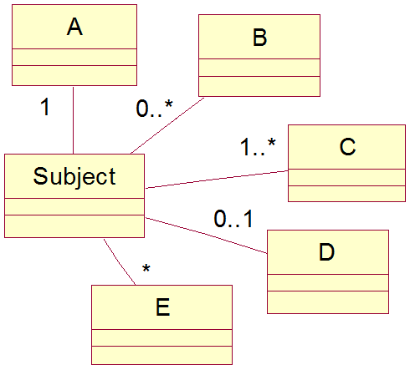
Multiplicity
The most common degree for relationships is binary.
Binary relationships are generally referred to as being:
one-to-one (1:1)
one-to-many (1:*)
many-to-many (*:*)
www.c-jump.com

Slide 21
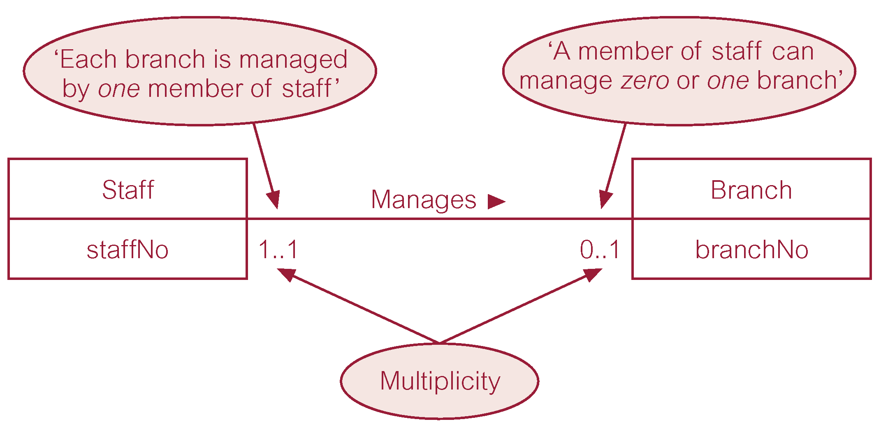
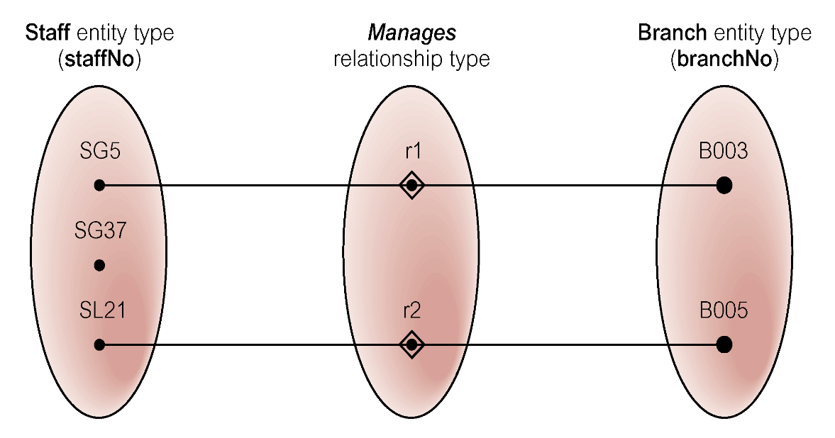
Multiplicity of Staff Manages Branch (1:1) relationship

Slide 22
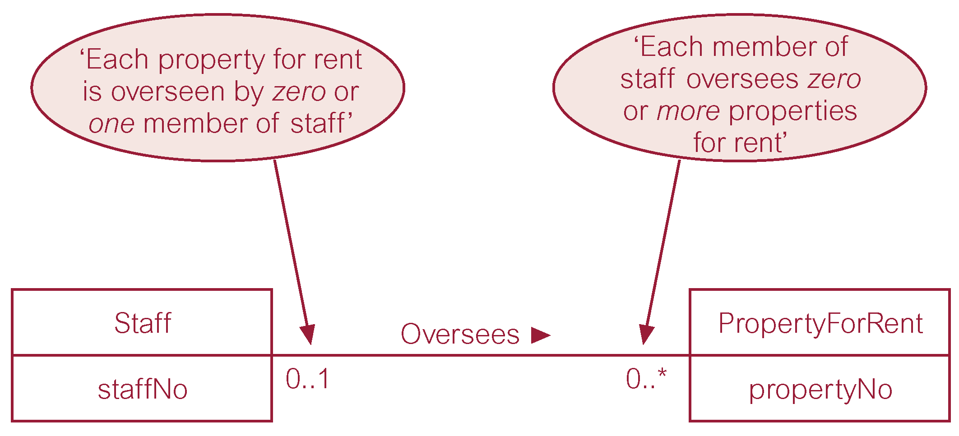
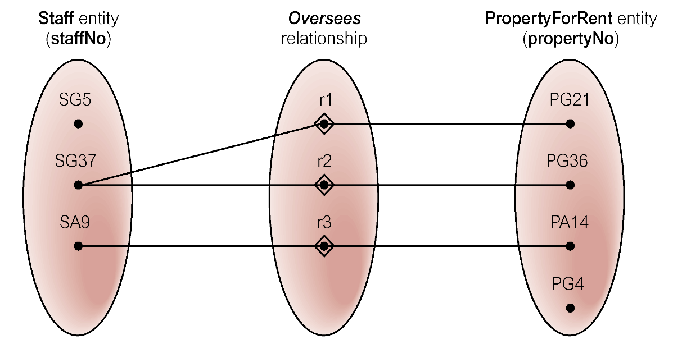
Multiplicity of Staff Oversees PropertyForRent (1:*) relationship type

Slide 23
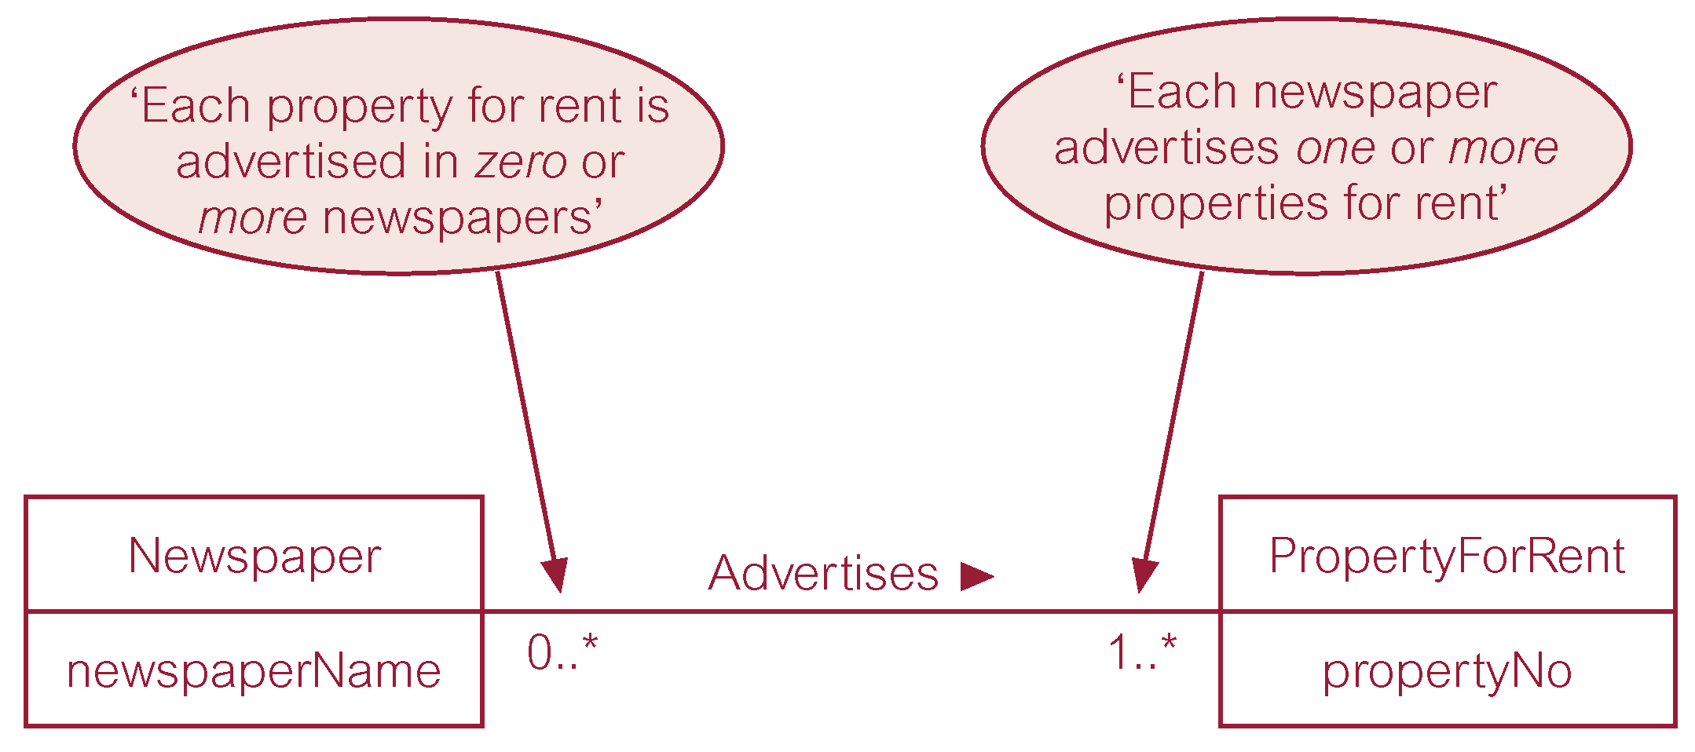
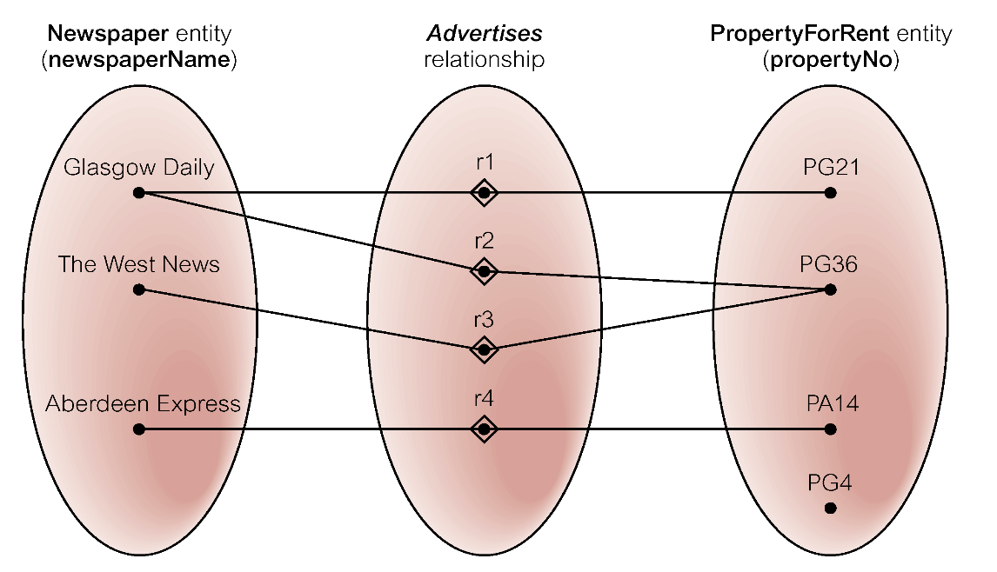
Multiplicity of Newspaper Advertises PropertyForRent (*:*) relationship

Slide 24
Structural Constraints
Multiplicity
Cardinality
Describes maximum number of possible relationship occurrences for an entity participating in a given relationship type.
Participation
Determines whether all or only some entity occurrences participate in a relationship.

Slide 25
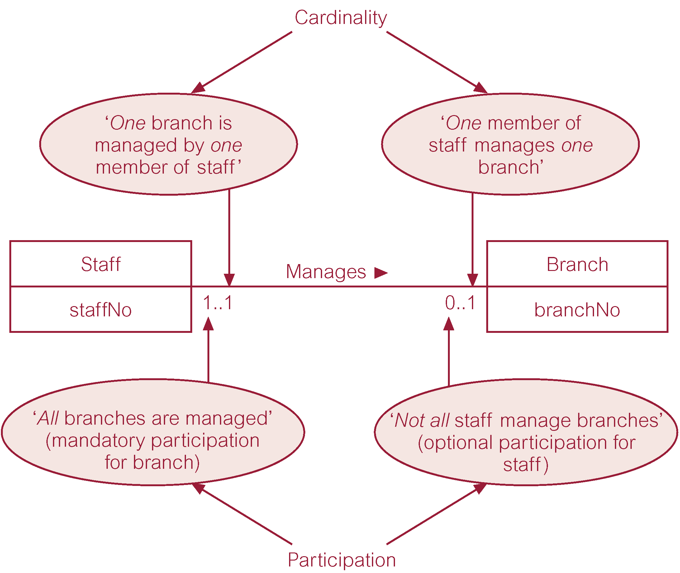
Structural Constraints
Multiplicity

Slide 26

Problems with ER Models
Problems may arise when designing a conceptual data model called connection traps.
Often due to a misinterpretation of the meaning of certain relationships.
Two main types of connection traps are called fan traps and chasm traps.
thethoughtgardener.com

Slide 27
Problems with ER Models
Fan Trap
Where a model represents a relationship between entity types, but pathway between certain entity occurrences is ambiguous.
Chasm Trap
Where a model suggests the existence of a relationship between entity types, but pathway does not exist between certain entity occurrences.

Slide 28

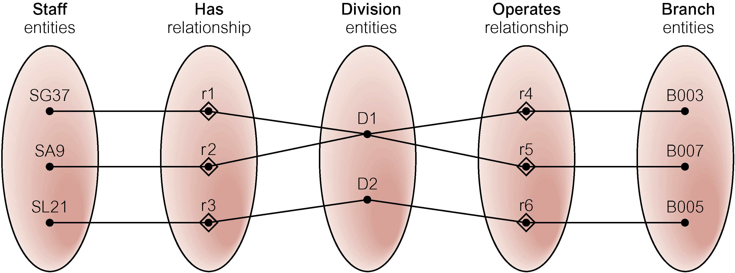
Fan Trap
At which branch office does staff number SG37 work?

Slide 29
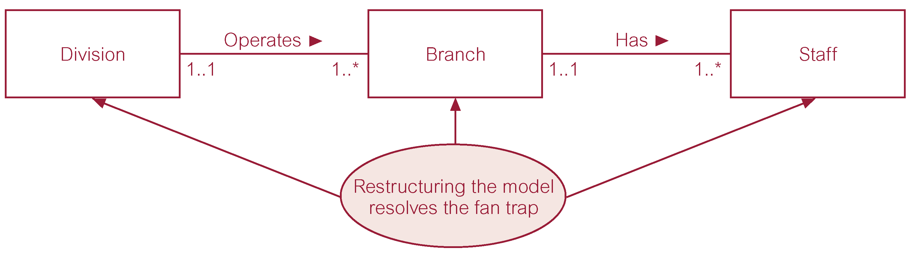
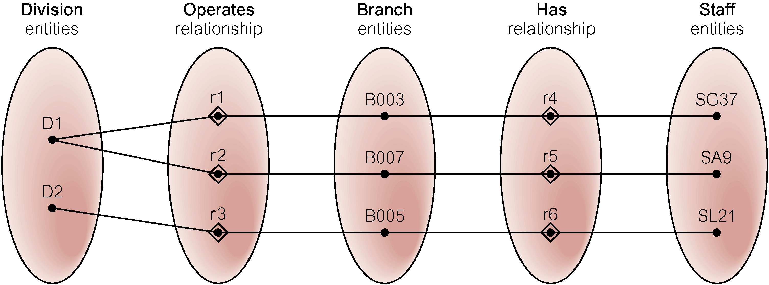
Fan Trap Solution
SG37 works at branch B003

Slide 30

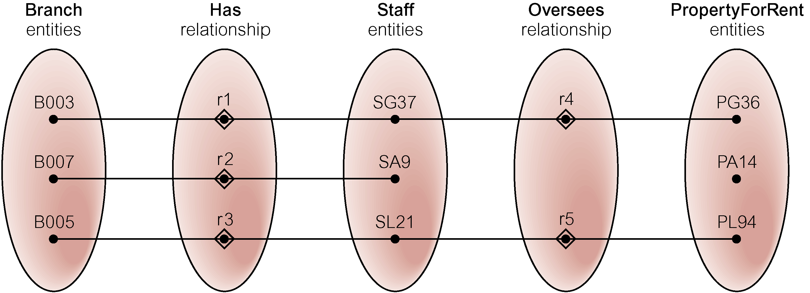
Chasm Trap
At which branch office is property PA14 available?

Slide 31
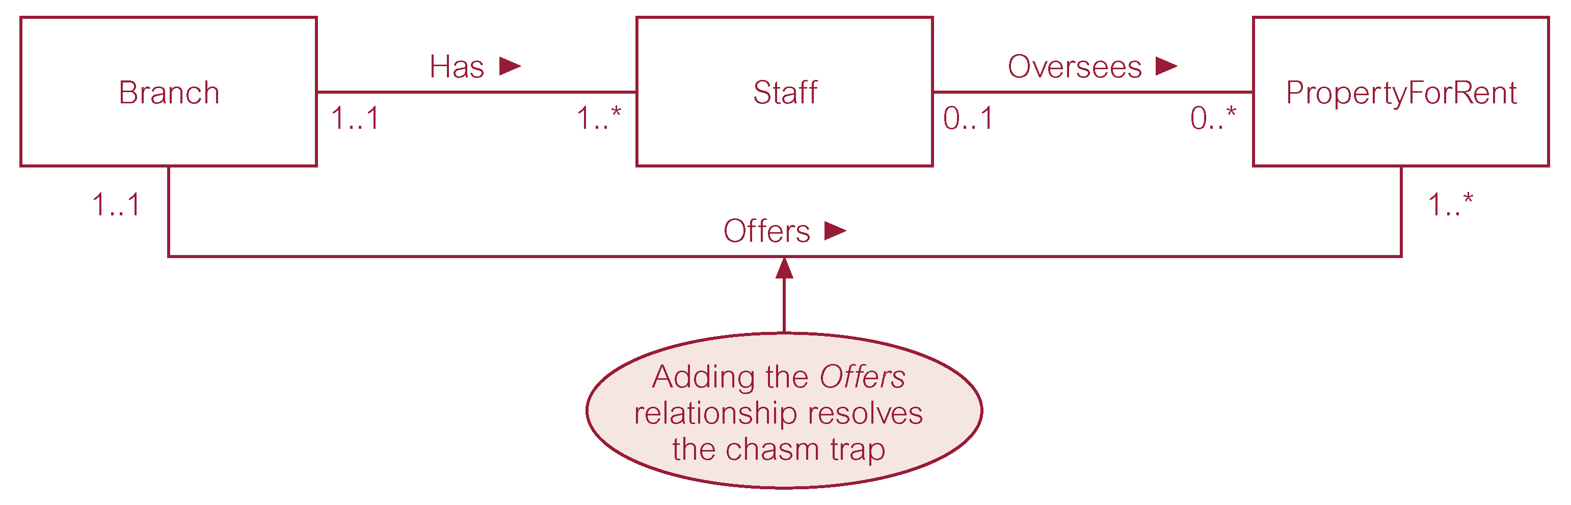

Chasm Trap Solution
www.quadrobay.com

Slide 32
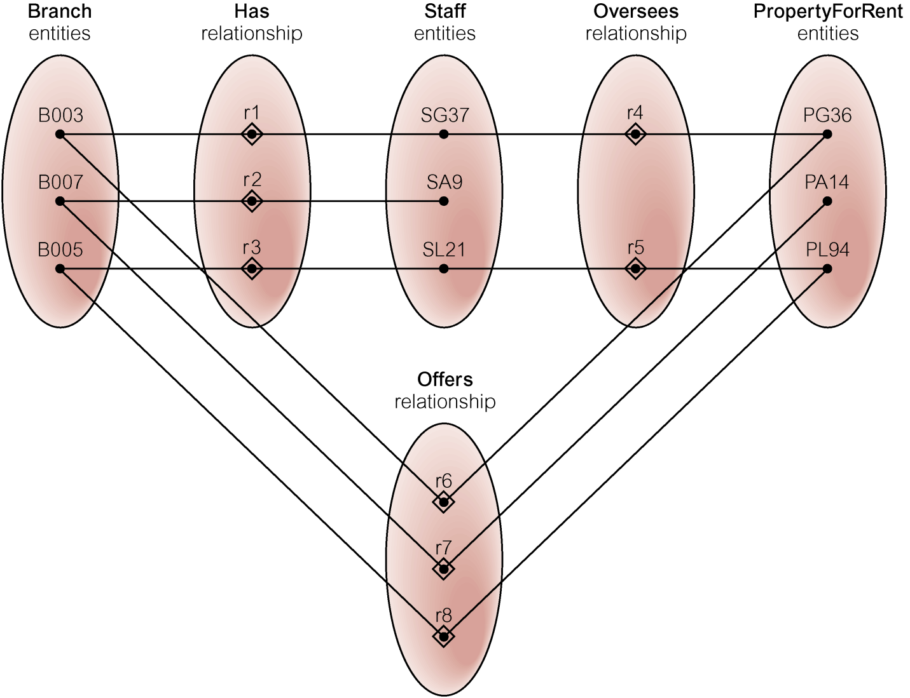
Chasm Trap Solution

Slide 33
CHAPTER 9 OBJECT RELATIONAL DBMS

Slide 34
Weaknesses of RDBMSs
Poor Representation of “Real World” Entities
Normalization leads to relations that do not correspond to entities in “real world”.
Semantic Overloading
Relational model has only one construct for representing data and data relationships: the relation.
Relational model is semantically overloaded.
Poor Support for Integrity and General Constraints
Homogeneous Data Structure
Relational model assumes both horizontal and vertical homogeneity.
Many RDBMSs now allow Binary Large Objects (BLOBs).

Slide 35
Weaknesses of RDBMSs
Limited Operations
RDBMSs only have a fixed set of operations which cannot be extended.
Difficulty Handling Recursive Queries
Atomicity of data means that repeating groups are not allowed in the relational model.
Extremely difficult to produce recursive queries (queries about relationships that a relation has with itself (directly or indirectly) → see page 300 for details explanation

Slide 36
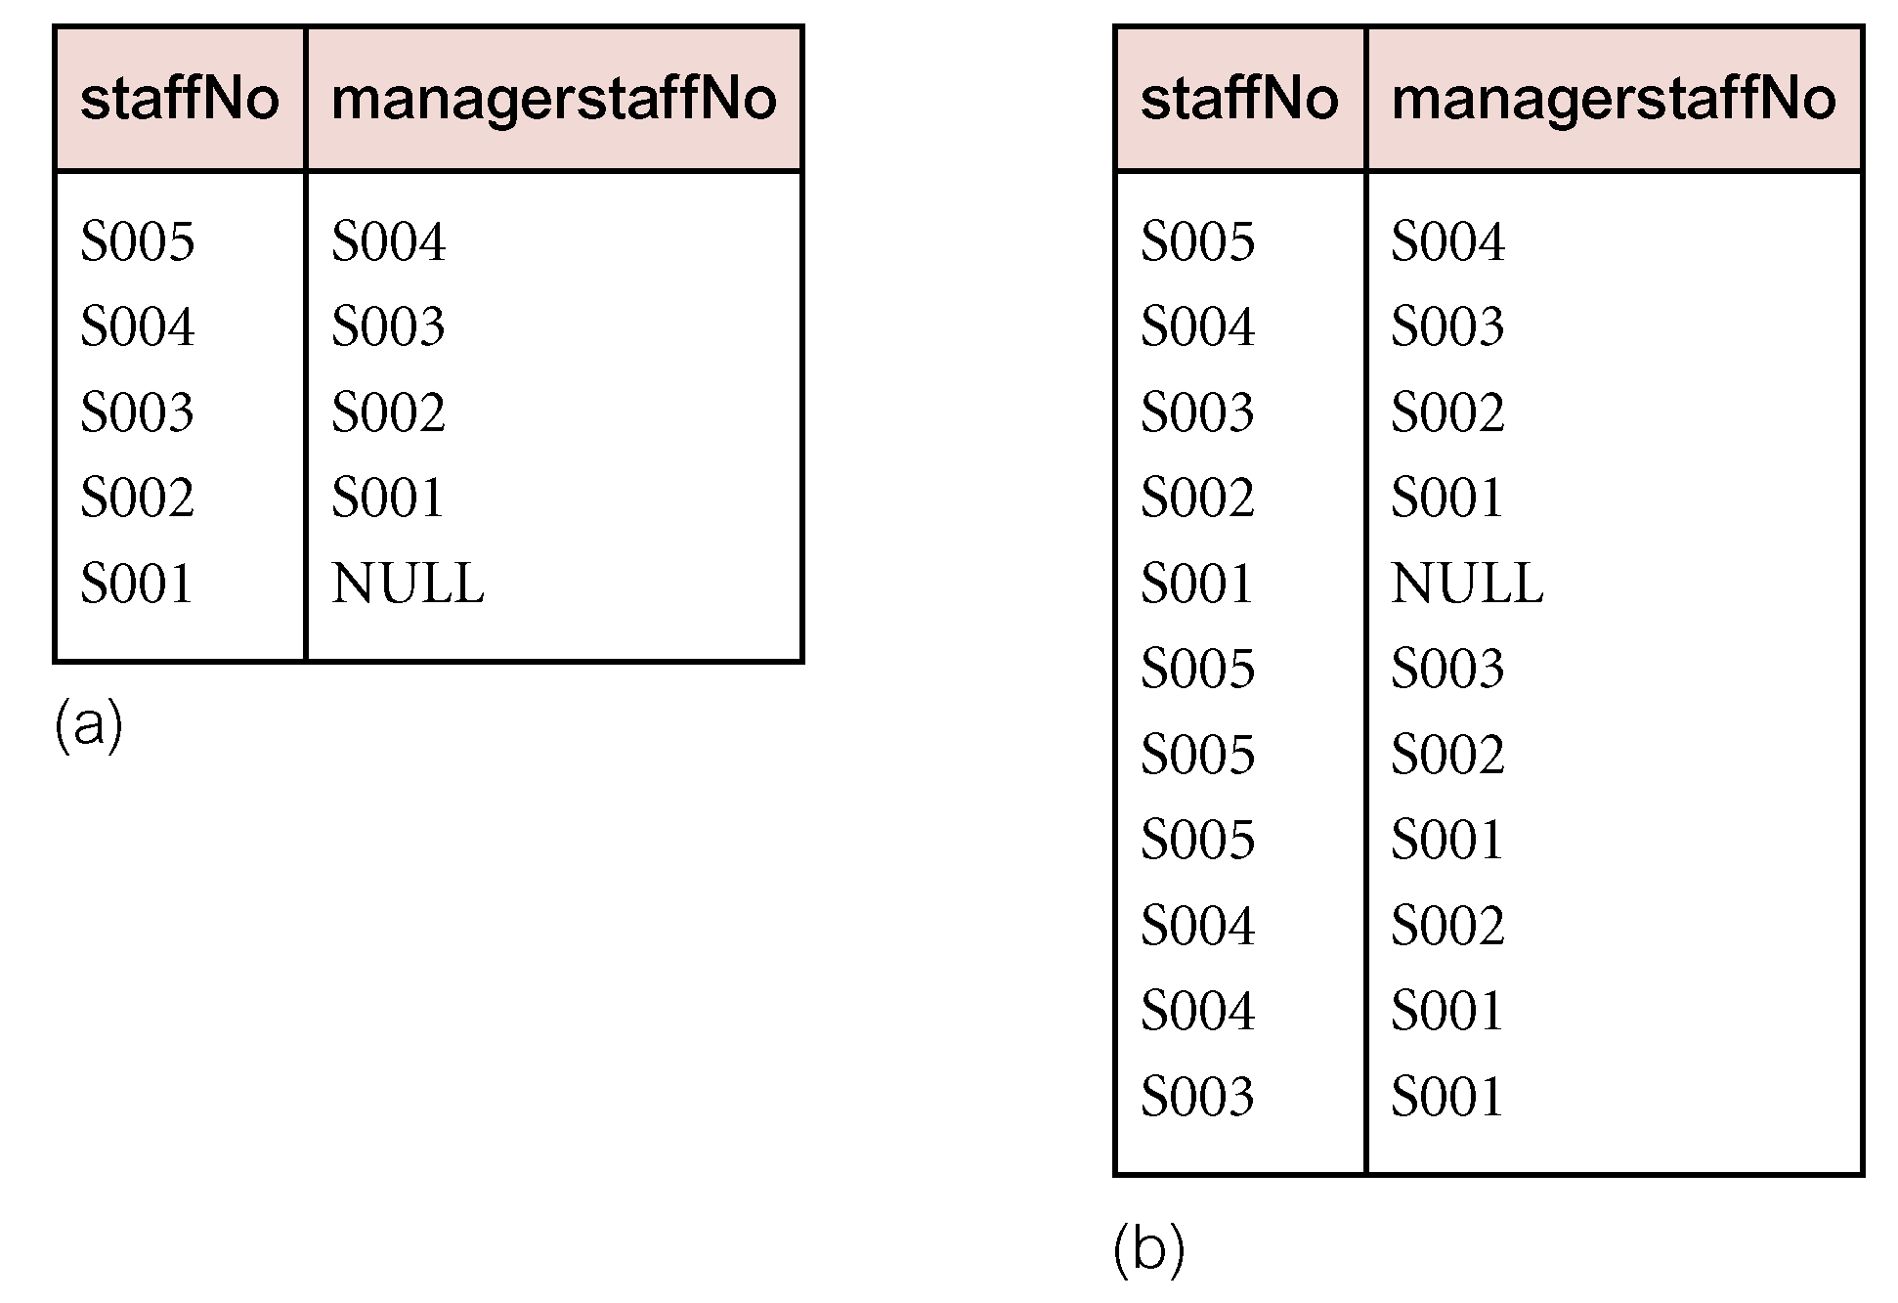
Example - Recursive Query

Slide 37
Weaknesses of RDBMSs
Impedance Mismatch
Most DMLs lack computational completeness.
To overcome this, SQL can be embedded in a high-level 3GL.
This produces an impedance mismatch - mixing different programming paradigms.
Estimated that as much as 30% of programming effort and code space is expended on this type of conversion.
Other Problems with RDBMSs
Transactions are generally short-lived and concurrency control protocols not suited for long-lived transactions.
Schema changes are difficult.
RDBMSs are poor at navigational access.

Slide 38
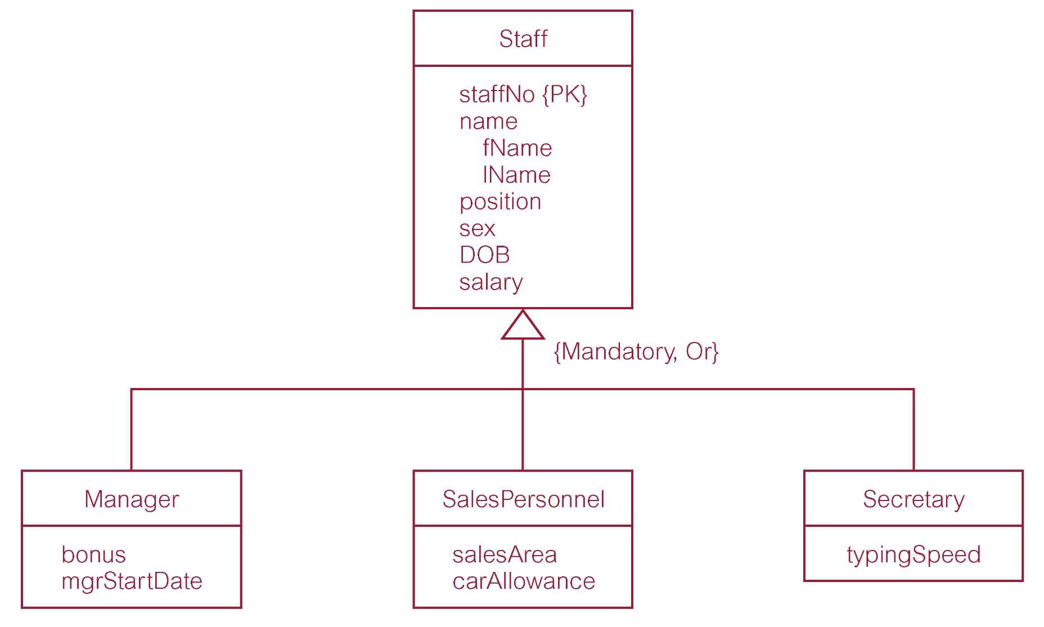
Storing Objects in Relational Databases

Slide 39
Mapping Classes to Relations – 3 Alternatives
(1) Map each class or subclass to a relation:
Staff (staffNo, fName, lName, position, sex, DOB, salary)
Manager (staffNo, bonus, mgrStartDate)
SalesPersonnel (staffNo, salesArea, carAllowance)
Secretary (staffNo, typingSpeed)
(2) Map each subclass to a relation
Manager (staffNo, fName, lName, position, sex, DOB, salary, bonus, mgrStartDate)
SalesPersonnel (staffNo, fName, lName, position, sex, DOB, salary, salesArea, carAllowance)
Secretary (staffNo, fName, lName, position, sex, DOB, salary, typingSpeed)

Slide 40

Mapping Classes to Relations – 3 Alternatives
(3) Map the hierarchy to a single relation
Staff (staffNo, fName, lName, position, sex, DOB, salary, bonus, mgrStartDate, salesArea, carAllowance, typingSpeed, typeFlag)
www.enrichedcloud.com

Slide 41
ORDBMSs - Features
OO features being added include:
user-extensible types,
encapsulation,
inheritance,
polymorphism,
dynamic binding of methods,
complex objects including non-1NF objects,
object identity.
However, no single extended relational model.
All models:
share basic relational tables and query language,
all have some concept of ‘object’,
some can store methods (or procedures or triggers).
Some analysts predict ORDBMS will have 50% larger share of market than RDBMS.

Slide 42
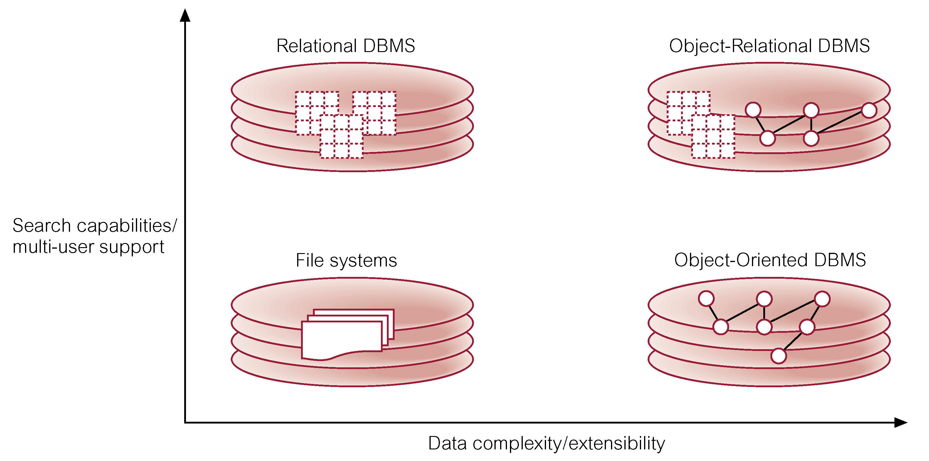
Four Quadrant View of the Database World

Slide 43

Advantages of ORDBMSs
Resolves many of known weaknesses of RDBMS.
Reuse and sharing:
reuse comes from ability to extend server to perform standard functionality centrally;
gives rise to increased productivity both for developer and end-user.
Preserves significant body of knowledge and experience gone into developing relational applications.
www.bowelcanceraustralia.org

Slide 44

Disadvantages of ORDBMSs
Complexity.
Increased costs.
Proponents of relational approach believe simplicity and purity of relational model are lost.
Some believe RDBMS is being extended for what will be a minority of applications.
OO purists not attracted by extensions either.
SQL now extremely complex.
www.bowelcanceraustralia.org

Slide 45
Subtypes and Supertypes
User Defined Types (UDT) can participate in subtype/supertype hierarchy using UNDER clause.
This concept is same with Superclass and Subclasses
Multiple inheritance is not supported.
Subtype inherits all the attributes and behavior of its supertypes.
Can define additional attributes and methods and can override inherited methods.
Concept of substitutability supported: whenever instance of supertype expected instance of subtype can be used in its place.

Slide 46
Example - Creation of Subtype
CREATE TYPE StaffType UNDER PersonType AS (
staffNo VARCHAR(5),
position VARCHAR(10) DEFAULT ‘Assistant’,
salary DECIMAL(7, 2),
branchNo CHAR(4))
INSTANTIABLE
NOT FINAL
INSTANCE METHOD isManager() RETURNS BOOLEAN;

Slide 47
Example - Creation of Subtype
CREATE INSTANCE METHOD isManager ()
RETURNS BOOLEAN FOR StaffType
BEGIN
IF SELF.position = ‘Manager’ THEN
RETURN TRUE;
ELSE
RETURN FALSE;
END IF
END)

Slide 48
Example - Creation of Subtable
CREATE TABLE Staff OF StaffType UNDER Person;
Each row of supertable Person can correspond to at most one row in Staff.
Each row in Staff must have exactly one corresponding row in Person.
Containment used: row of subtable ‘contained’ in one of its supertables.

Slide 49
Example - Using Reference Type to Define a Relationship
CREATE TABLE PropertyForRent (
propertyNo PropertyNumber NOT NULL,
street Street NOT NULL,
….
staffID REF(StaffType) SCOPE Staff
REFERENCES ARE CHECKED ON DELETE CASCADE,
PRIMARY KEY (propertyNo));

Slide 50
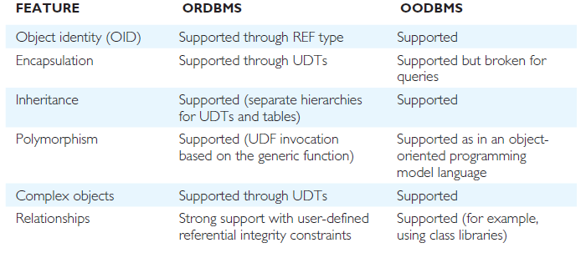
Comparison of ORDBMS and OODBMS – Data Modeling

Slide 51
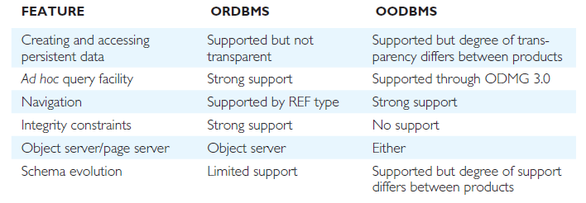
Comparison of ORDBMS and OODBMS – Data Access

Slide 52
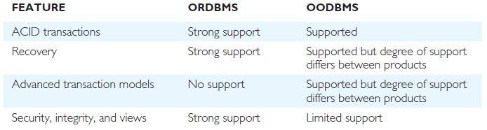
Comparison of ORDBMS and OODBMS – Data Sharing
Pearson Education © 2014
52

Slide 53
CHAPTER 30 SEMI STRUCTURED DATA AND XML

Slide 54
Semistructured Data
Data that may be irregular or incomplete and have a structure that may change rapidly or unpredictably.
Semistructured data is data that has some structure, but structure may not be rigid, regular, or complete.
Generally, data does not conform to fixed schema (sometimes use terms schema-less or self-describing).
Information normally associated with schema is contained within data itself.
Some forms of semistructured data have no separate schema, in others it exists but only places loose constraints on data.
Unfortunately, relational, object-oriented, and object-relational DBMSs do not handle data of this nature particularly well.

Slide 55
Semistructured Data
Has gained importance recently for various reasons:
may be desirable to treat Web sources like a database, but cannot constrain these sources with a schema;
may be desirable to have a flexible format for data exchange between disparate databases;
emergence of XML as standard for data representation and exchange on the Web, and similarity between XML documents and semistructured data.

Slide 56
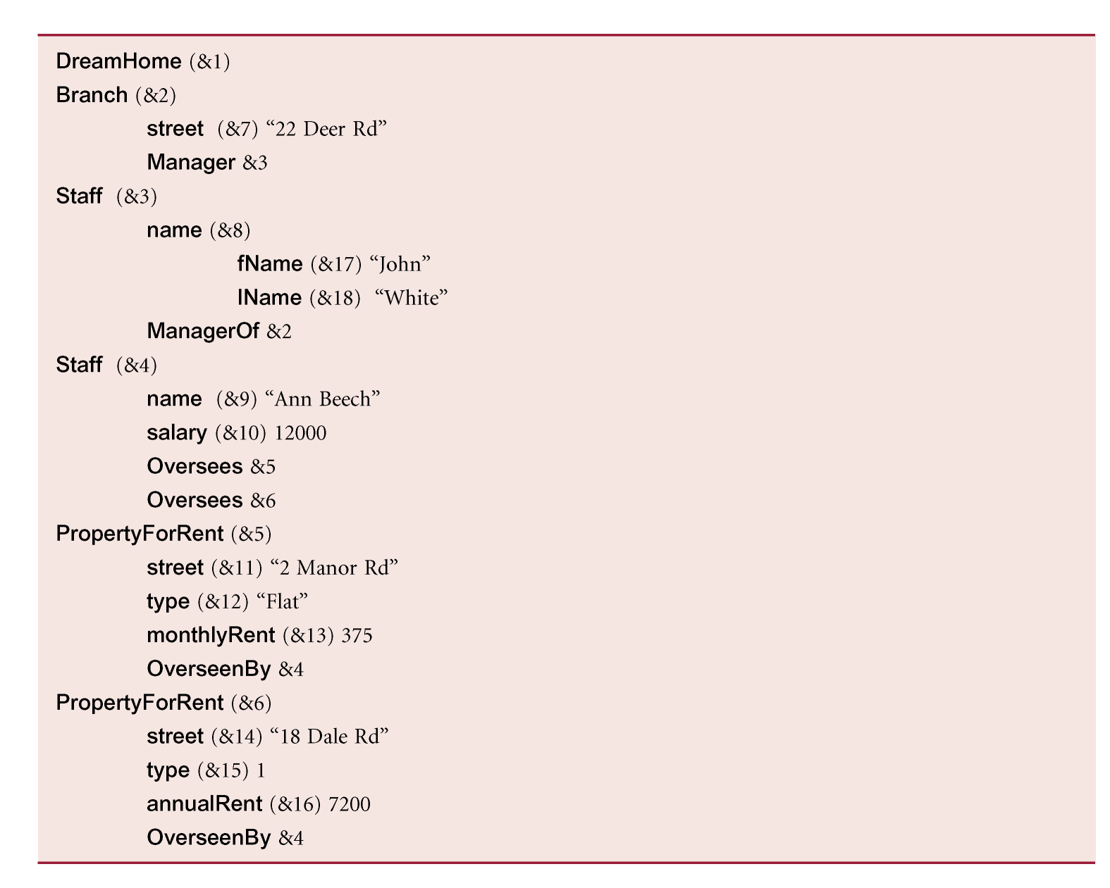
Example 30.1

Slide 57
Example 30.1
Note, data is not regular:
for John White, hold first and last names, but for Ann Beech store single name and also store a salary;
for property at 2 Manor Rd, store a monthly rent whereas for property at 18 Dale Rd, store an annual rent;
for property at 2 Manor Rd, store property type (flat) as a string, whereas for property at 18 Dale Rd, store type (house) as an integer value.

Slide 58
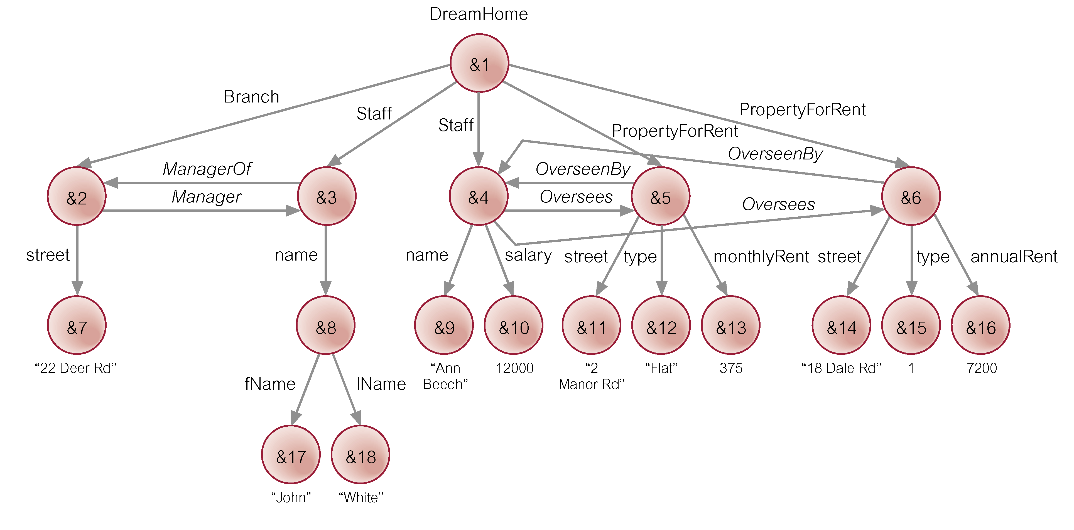
Example 30.1
A graphical representation of the data shown in previous slide

Slide 59
Object Exchange Model (OEM)
A label indicates what the object represents and is used to identify the object and to convey the meaning of the object, and so should be as informative as possible.
Labels can change dynamically.
A name is a special label that serves as an alias for a single object and acts as an entry point into the database (for example, DreamHome is a name that denotes object &1).
An OEM object can be considered as a quadruple (label, oid, type, value).
For example:
{Staff, &4, set, {&9, &10}}
{name, &9, string, “Ann Beech”}
{salary, &10, decimal, 12000}

Slide 60
Lore and Lorel
Lore (Lightweight Object REpository), is a multi-user DBMS, supporting crash recovery, materialized views, bulk loading of files in some standard format (XML is supported), and a declarative update language.
Has an external data manager that enables data from external sources to be fetched dynamically and combined with local data during QP.

Slide 61
Lorel
Lorel (the Lore language) is an extension to OQL. Lorel was intended to handle:
queries that return meaningful results even when some data is absent;
queries that operate uniformly over single-valued and set-valued data;
queries that operate uniformly over data with different types;
queries that return heterogeneous objects;
queries where the object structure is not fully known.

Slide 62
Lore and Lorel
Also supports general path expression that provides for arbitrary paths:
‘|’ indicates selection;
‘?’ indicates zero or one occurrences;
‘+’ indicates one or more occurrences;
‘*’ indicates zero or more occurrences.
For example:
DreamHome.(Branch | PropertyForRent).street
would match path beginning with DreamHome, followed by either a Branch edge or a PropertyForRent edge, followed by a street edge.
Lorel query example can be seen on page 1134

Slide 63
XML (eXtensible Markup Language)
A meta-language (a language for describing other languages) that enables designers to create their own customized tags to provide functionality not available with HTML.
Most documents on Web currently stored and transmitted in HTML.
One strength of HTML is its simplicity. Simplicity may also be one of its weaknesses, with users wanting tags to simplify some tasks and make HTML documents more attractive and dynamic.
To satisfy this demand, vendors introduced some browser-specific HTML tags, making it difficult to develop sophisticated, widely viewable Web documents.
W3C (World Wide Web Consortium) has produced XML, which could preserve general application independence that makes HTML portable and powerful.

Slide 64
XML
XML is a restricted version of SGML (Standard Generalized Markup Language), designed especially for Web documents.
SGML allows document to be logically separated into two: one that defines the structure of the document (DTD), other containing the text itself.
By giving documents a separately defined structure, and by giving authors ability to define custom structures, SGML provides extremely powerful document management system.
However, SGML has not been widely adopted due to its inherent complexity.

Slide 65
XML
XML attempts to provide a similar function to SGML, but is less complex and, at same time, network-aware.
XML retains key SGML advantages of extensibility, structure, and validation.
Since XML is a restricted form of SGML, any fully compliant SGML system will be able to read XML documents (although the opposite is not true).
XML is not intended as a replacement for SGML or HTML.

Slide 66
Advantages of XML
Simplicity
Open standard and platform/vendor-independent
Extensibility
Reuse
Separation of content and presentation
Improved load balancing
Support for integration of data from multiple sources
Ability to describe data from a wide variety of applications
More advanced search engines
New opportunities.

Slide 67
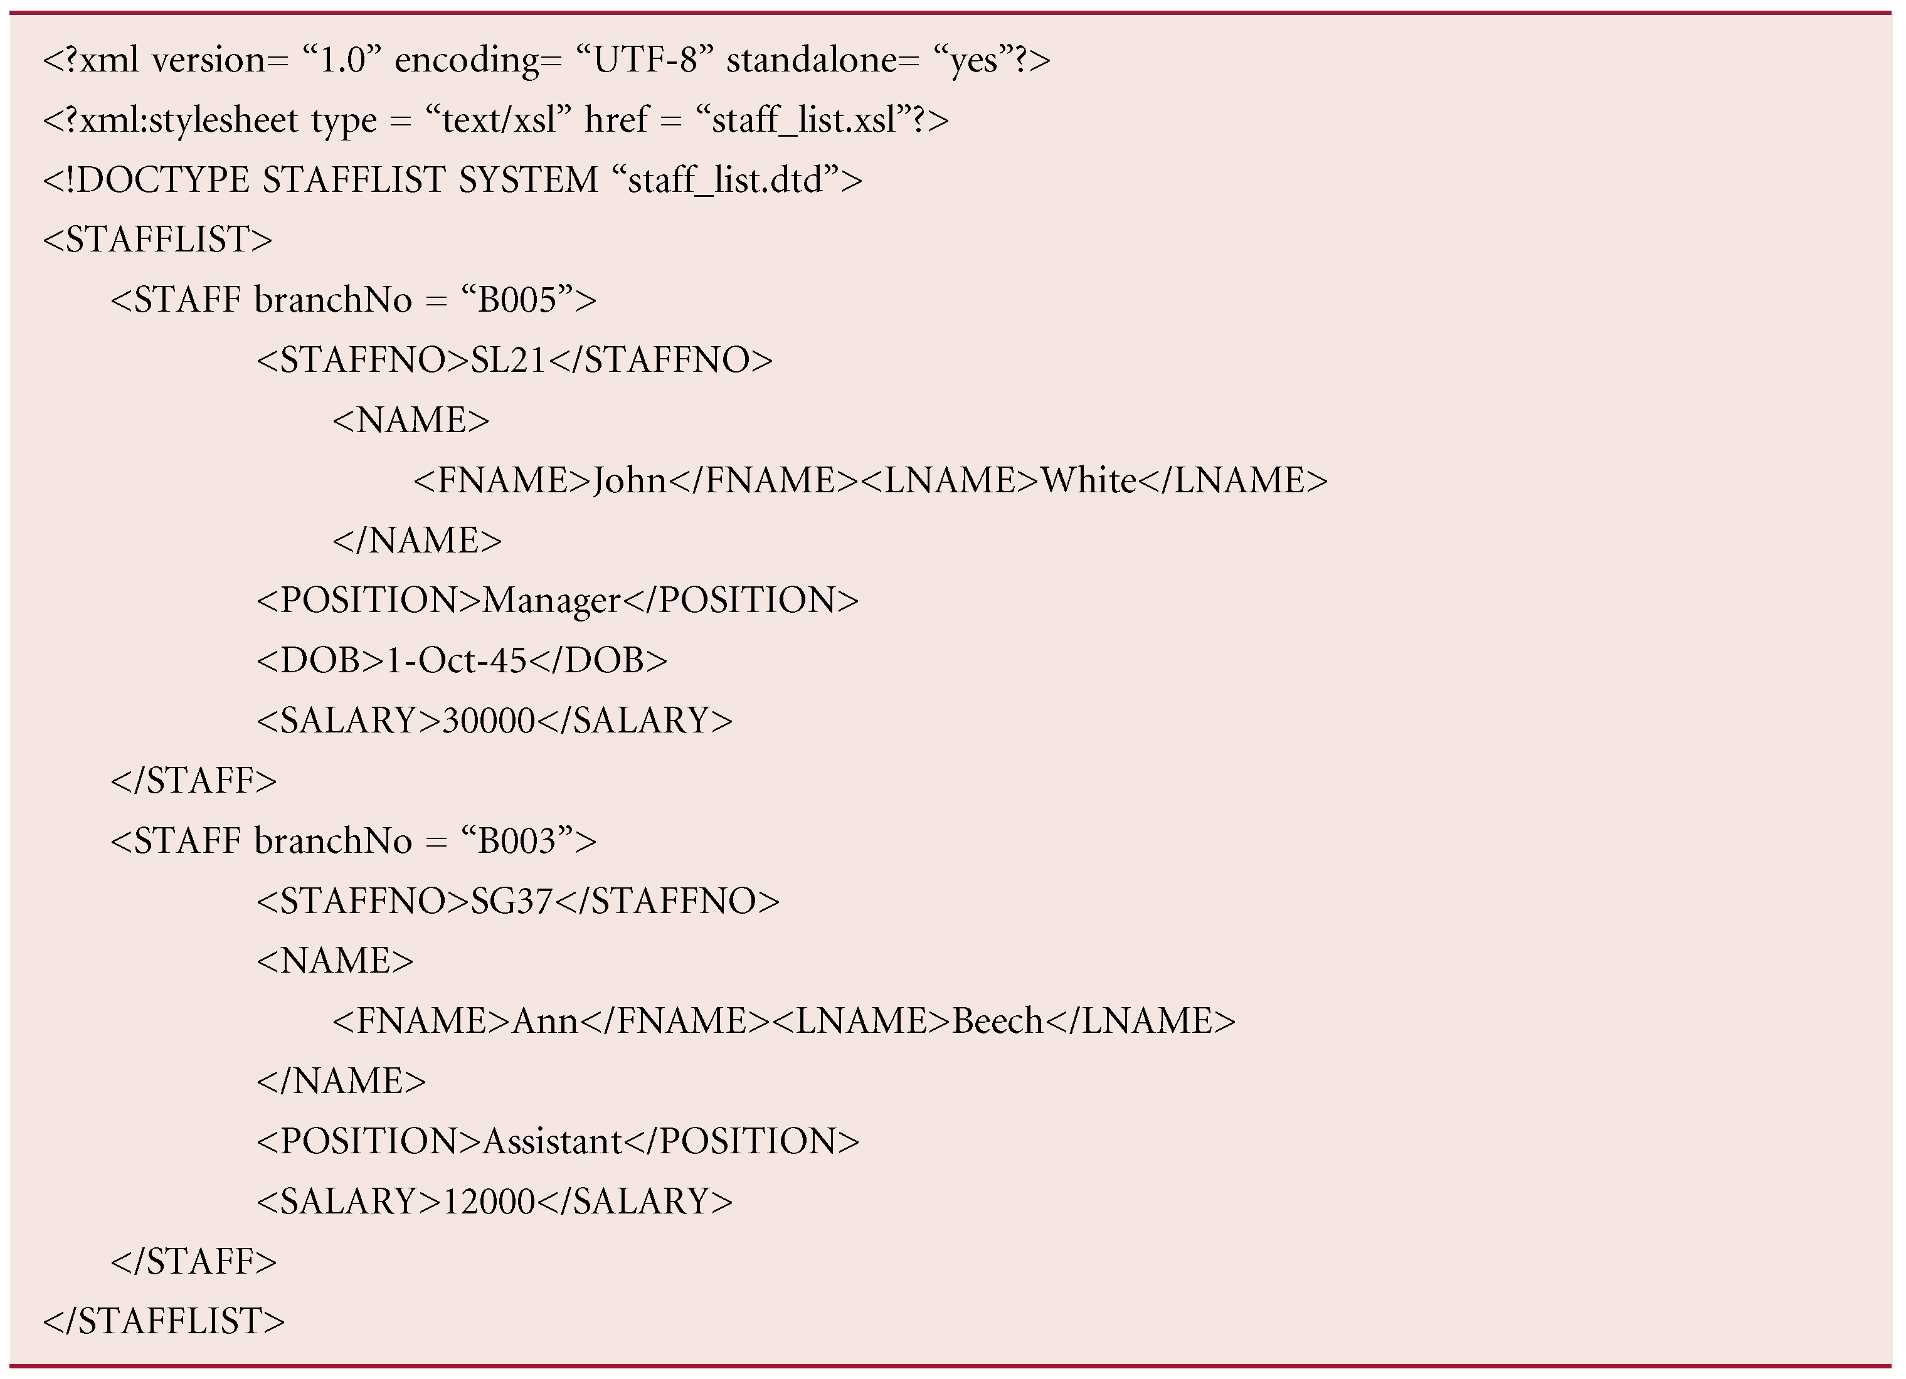
XML

Slide 68
XML - Elements
Elements, or tags, are most common form of markup.
First element must be a root element, which can contain other (sub)elements.
XML document must have one root element (<STAFFLIST>. Element begins with start-tag (<STAFF>) and ends with end-tag (</STAFF>).
XML elements are case sensitive
An element can be empty, in which case it can be abbreviated to <EMPTYELEMENT/>.
Elements must be properly nested.

Slide 69
XML - Attributes
Attributes are name-value pairs that contain descriptive information about an element.
Attribute is placed inside start-tag after corresponding element name with the attribute value enclosed in quotes.
<STAFF branchNo = “B005”>
Could also have represented branch as subelement of STAFF.
A given attribute may only occur once within a tag, while subelements with same tag may be repeated.

Slide 70
XML – Other Sections
XML declaration: optional at start of XML document.
Entity references: serve various purposes, such as shortcuts to often repeated text or to distinguish reserved characters from content.
Comments: enclosed in <!– and --> tags.
CDATA sections: instructs XML processor to ignore markup characters and pass enclosed text directly to application.
Processing instructions: can also be used to provide information to application.

Slide 71
XML – Ordering
Semistructured data model described earlier assumes collections are unordered.
In XML, elements are ordered.
In contrast, in XML attributes are unordered.

Slide 72
XML Query Languages
Data extraction, transformation, and integration are well-understood database issues that rely on a query language.
SQL and OQL do not apply directly to XML because of the irregularity of XML data.
However, XML data similar to semistructured data. There are many semistructured query languages that can query XML documents, including XML-QL, UnQL, and XQL.
All have notion of a path expression for navigating nested structure of XML.

Slide 73
Example XML-QL
Find surnames of staff who earn more than £30,000.
WHERE <STAFF>
<SALARY> $S </SALARY>
<NAME><FNAME> $F </FNAME> <LNAME> $L </LNAME></NAME>
</STAFF> IN “http://www.dh.co.uk/staff.xml”
$S > 30000
CONSTRUCT <LNAME> $L </LNAME>

Slide 74
XQuery
XQuery derived from XML query language called Quilt, which has borrowed features from XPath, XML-QL, SQL, OQL, Lorel, XQL, and YATL.
Like OQL, XQuery is a functional language in which a query is represented as an expression.
XQuery supports several kinds of expression, which can be nested (supporting notion of a subquery).

Slide 75
XQuery – Path Expressions
Uses syntax of XPath.
In XQuery, result of a path expression is ordered list of nodes, including their descendant nodes, ordered according to their position in original hierarchy, top-down, left-to-right order.
Result of path expression may contain duplicate values.
Each step in path expression represents movement through document in particular direction, and each step can eliminate nodes by applying one or more predicates.
Result of each step is list of nodes that serves as starting point for next step.
Path expression can begin with an expression that identifies a specific node, such as function doc(string), which returns root node of named document.
Query can also contain path expression beginning with “/” or “//”, which represents an implicit root node determined by the environment in which query is executed.

Slide 76
Example 30.4 – XQuery Path Expressions
Find staff number of first member of staff in our XML document.
doc(“staff_list.xml”)/STAFFLIST/STAFF[1]//STAFFNO
Four steps:
first opens staff_list.xml and returns its document node;
second uses /STAFFLIST to select STAFFLIST element at top;
third locates first STAFF element that is child of root element;
fourth finds STAFFNO elements occurring anywhere within this STAFF element.
Knowing structure of document, could also express this as:
doc(“staff_list.xml”)//STAFF[1]/STAFFNO
doc(“staff_list.xml”)/STAFFLIST/STAFF[1]/STAFFNO

Slide 77
Example 30.4 – XQuery Path Expressions
Find staff numbers of first two members of staff.
doc(“staff_list.xml”)/STAFFLIST/STAFF[1 TO 2]/
STAFFNO

Slide 78
Example 30.4 – XQuery Path Expressions
Find surnames of staff at branch B005.
doc(“staff_list.xml”)/STAFFLIST/
STAFF[@branchNo =“B005”]//LNAME
Five steps:
first two as before;
third uses /STAFF to select STAFF elements within STAFFLIST element;
fourth consists of predicate that restricts STAFF elements to those with branchNo attribute = B005;
fifth selects LNAME element(s) occurring anywhere within these elements.

Slide 79
XQuery – FLWOR Expressions
FLWOR (“flower”) expression is constructed from FOR, LET, WHERE, ORDER BY, RETURN clauses.
FLWOR expression starts with one or more FOR or LET clauses in any order, followed by optional WHERE clause, optional ORDER BY clause, and required RETURN clause.
FOR and LET clauses serve to bind values to one or more variables using expressions (e.g., path expressions).
FOR used for iteration, associating each specified variable with expression that returns list of nodes.
FOR clause can be thought of as iterating over nodes returned by its respective expression.

Slide 80
XQuery – FLWOR Expressions
LET clause also binds one or more variables to one or more expressions but without iteration, resulting in single binding for each variable.
Optional WHERE clause specifies one or more conditions to restrict tuples generated by FOR and LET.
RETURN clause evaluated once for each tuple in tuple stream and results concatenated to form result.
ORDER BY clause, if specified, determines order of the tuple stream which, in turn, determines order in which RETURN clause is evaluated using variable bindings in the respective tuples.

Slide 81
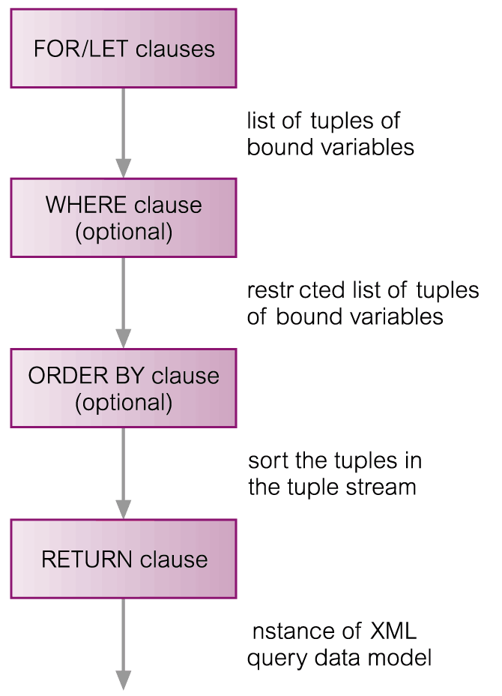
XQuery – FLWOR Expressions

Slide 82
Example 30.5 – XQuery FLWOR Expressions
List staff with salary = £30,000.
LET $SAL := 30000
RETURN doc(“staff_list.xml”)//STAFF[SALARY = $SAL]
Note, predicate seems to compare an element (SALARY) with a value (15000). In fact, ‘=’ operator extracts typed value of element resulting in a decimal value in this case, which is then compared with 15000.

Slide 83
Example 30.5 – XQuery FLWOR Expressions
‘=’ operator is a general comparison operator. XQuery also defines value comparison operators (‘eq’, ‘ne’, ‘lt’, ‘le’, ‘gt’, ‘ge’), which are used to compare two atomic values.
If either operand is a node, atomization is used to convert it to an atomic value.
If we try to compare an atomic value to an expression that returns multiple nodes, then a general comparison operator returns true if any value satisfies predicate; however, value comparison operator would raise an error.

Slide 84
Example 30.5 – XQuery FLWOR Expressions
List staff at branch B005 with salary > £15,000.
FOR $S IN doc(“staff_list.xml”)//STAFF
WHERE $S/SALARY > 15000 AND
$S/@branchNo = “B005”
RETURN $S/STAFFNO
Effective boolean value (EBV) of empty sequence is false; EBV also false if expression evaluates to: xsd:boolean value false, a numeric or binary zero, a zero-length string, or special float value NaN (not a number); EBV of any other sequence evaluates to true.

Slide 85
Example 30.5 – XQuery FLWOR Expressions
List all staff in descending order of staff number.
FOR $S IN doc(“staff_list.xml”)//STAFF
ORDER BY $S/STAFFNO DESCENDING”
RETURN $S/STAFFNO

Slide 86
Example 30.5 – XQuery FLWOR Expressions
List each branch office and average salary at branch.
FOR $B IN
distinct-values(doc(“staff_list.xml”)//@branchNo))
LET $avgSalary := avg(doc(“staff_list.xml”)//
STAFF[@branchNo = $B]/SALARY)
RETURN
<BRANCH>
<BRANCHNO>{ $B/text() }</BRANCHNO>,
<AVGSALARY>$avgSalary</AVGSALARY>
</BRANCH>

Slide 87
Example 30.5 – XQuery FLWOR Expressions
List branches that have more than 20 staff.
<LARGEBRANCHES> {
FOR $B IN
distinct-values(doc(“staff_list.xml”)//@branchNo)
LET $S := doc(“staff_list.xml”)//STAFF/[@branchNo = $B]
WHERE count($S) > 20
RETURN
<BRANCHNO>{ $B/text() }</BRANCHNO> }
</LARGEBRANCHES>

Slide 88
Example 30.5 – XQuery FLWOR Expressions
List branches with at least one member of staff with salary > £15,000.
<BRANCHESWITHLARGESALARIES> {
FOR $B IN
distinct-values(doc(“staff_list.xml”)//@branchNo)
LET $S := doc(“staff_list.xml”)//STAFF/[@branchNo = $B]
WHERE SOME $sal IN $S/SALARY
SATISFIES ($sal > 15000)
RETURN
<BRANCHNO>{ $B/text() }</BRANCHNO> }
</ BRANCHESWITHLARGESALARIES >

Slide 89
Example 30.6 – Joining Two Documents
List staff along with details of their next of kin.
FOR $S IN doc(“staff_list.xml”)//STAFF,
$NOK IN doc(“nok.xml”)//NOK
WHERE $S/STAFFNO = $NOK/STAFFNO
RETURN
<STAFFNO>{ $S, $NOK/NAME }</STAFFNO>

Slide 90
Example 30.6 – Joining Two Documents
List all staff along with their next of kin details.
FOR $S IN doc(“staff_list.xml”)//STAFF
RETURN
<STAFFNOK>
{ $S }
FOR $NOK IN doc(“nok.xml”)//NOK
WHERE $S/STAFFNO = $NOK/STAFFNO
RETURN $NOK/NAME
</STAFFNOK>

Slide 91
Example 30.6 – Joining Two Documents
List each branch office and staff who work there.
<BRANCHLIST>
FOR $B IN
distinct-values(doc(“staff_list.xml”)//@branchNo)
ORDER BY $B
RETURN
<BRANCHNO> { $B/text() } {
FOR $S IN doc(“staff_list.xml”)//STAFF
WHERE $S/@branchNo = $B
ORDER BY $S/STAFFNO
RETURN $S/STAFFNO, $S/NAME, $S/POSITION, $S/SALARY }
</BRANCHNO>
</BRANCHLIST>

Slide 92
Example 30.7 – User-Defined Function
Function to return staff at a given branch.
DEFINE FUNCTION staffAtBranch($bNo) AS element()* {
FOR $S IN doc(“staff_list.xml”)//STAFF
WHERE $S/@branchNo = $bNo
ORDER BY $S/STAFFNO
RETURN $S/STAFFNO, $S/NAME,
$S/POSITION, $S/SALARY
}
staffAtBranch($B)

Slide 93
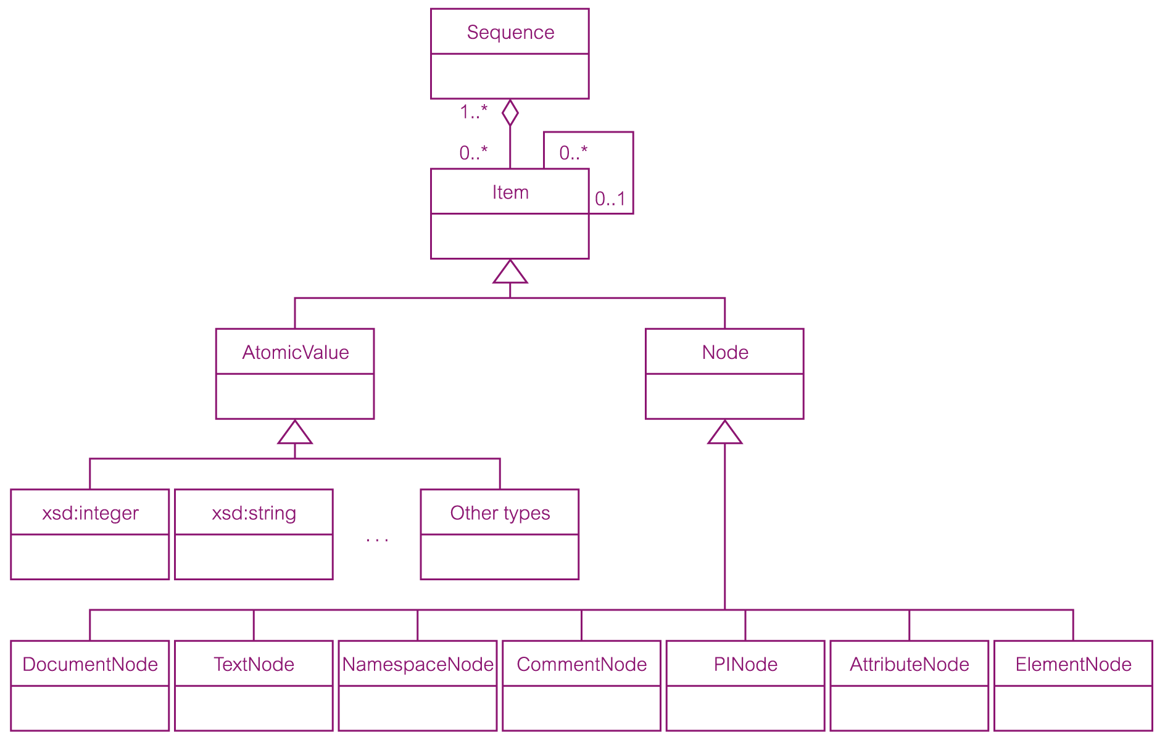
ER Diagram Representing Main Components of XML Query Data Model

Slide 94
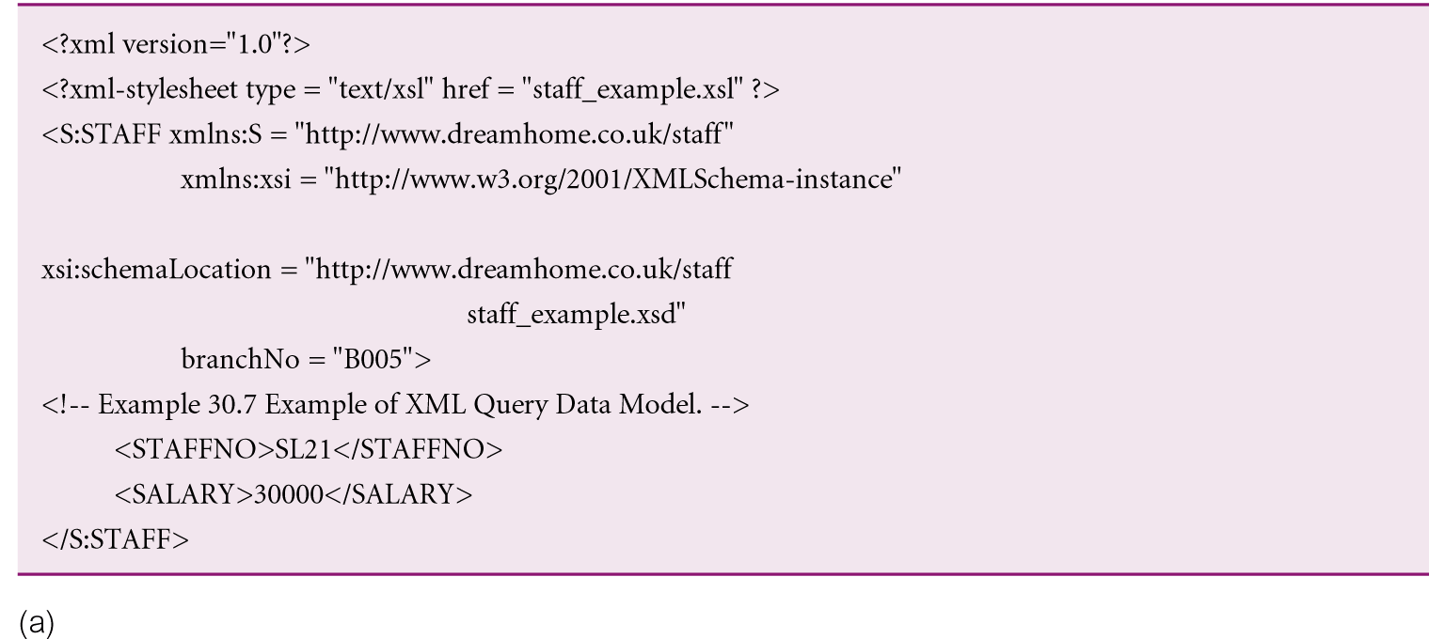
Example 30.8 - XML Query Data Model

Slide 95
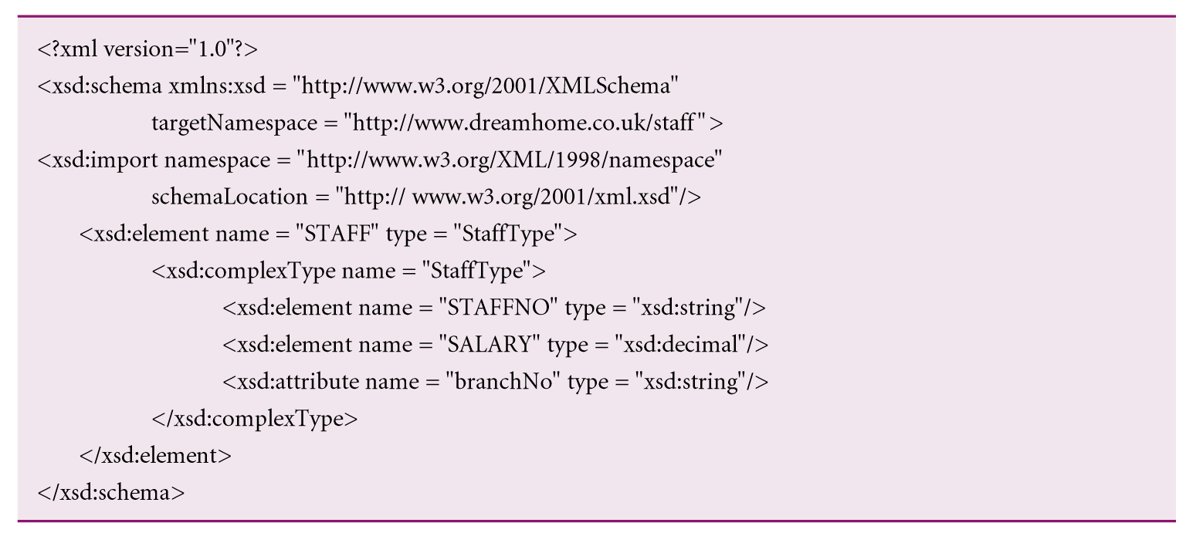
Example 30.8 - XML Query Data Model

Slide 96
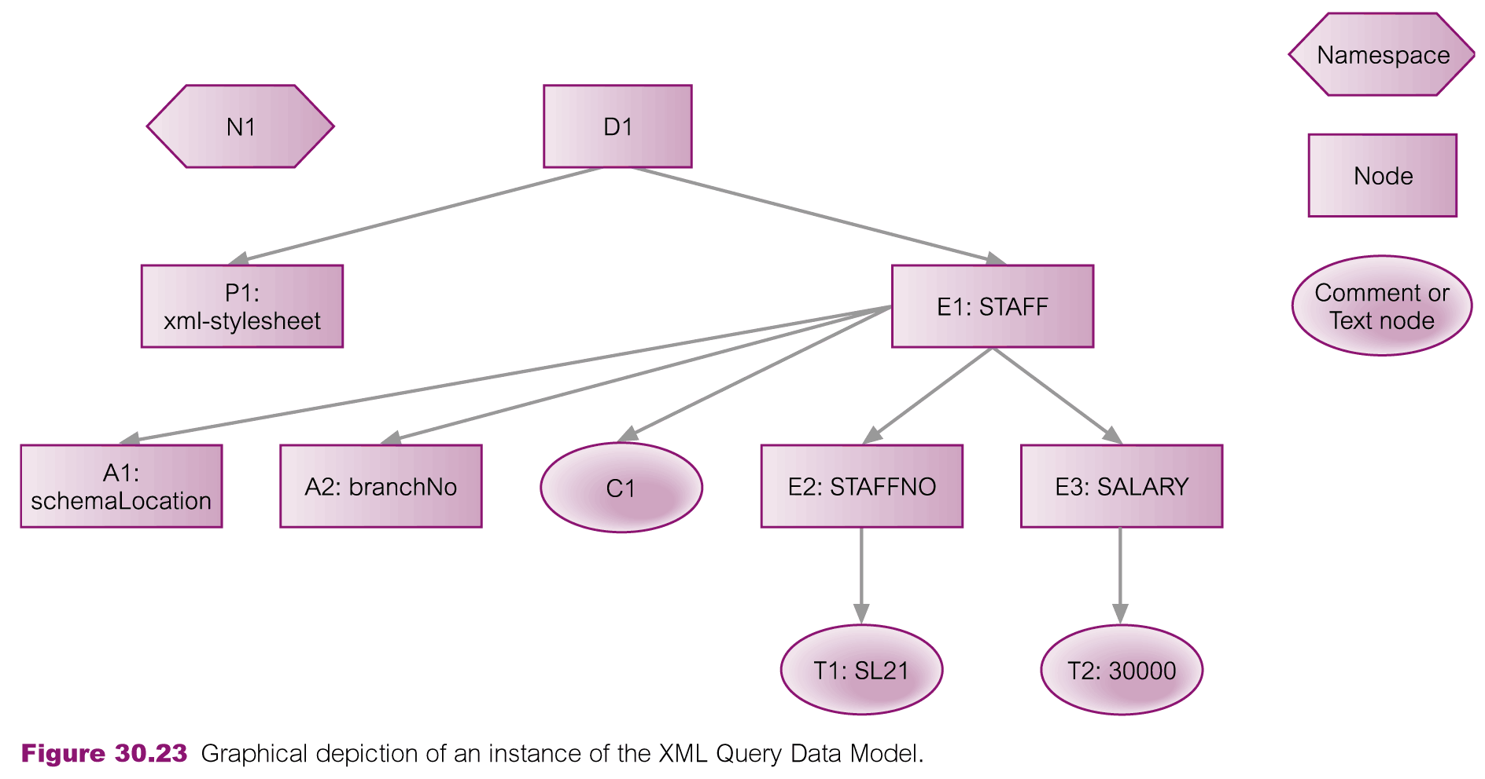
Example 30.8 - XML Query Data Model

Slide 97
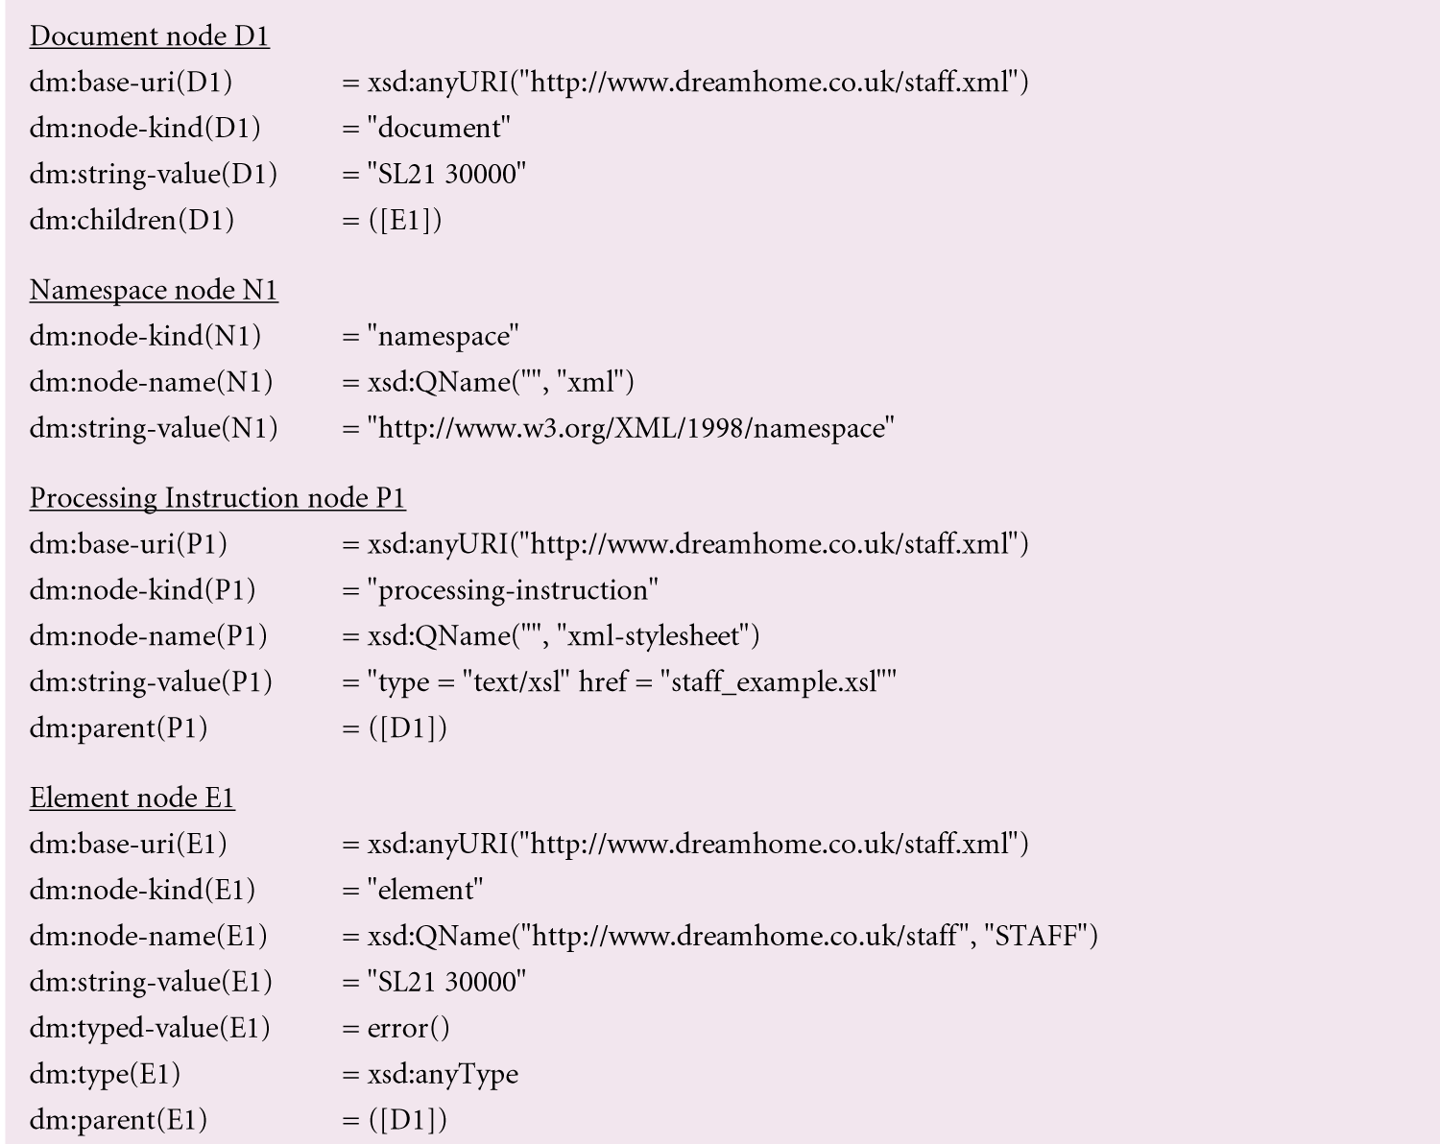
Example 30.8 - XML Query Data Model

Slide 98
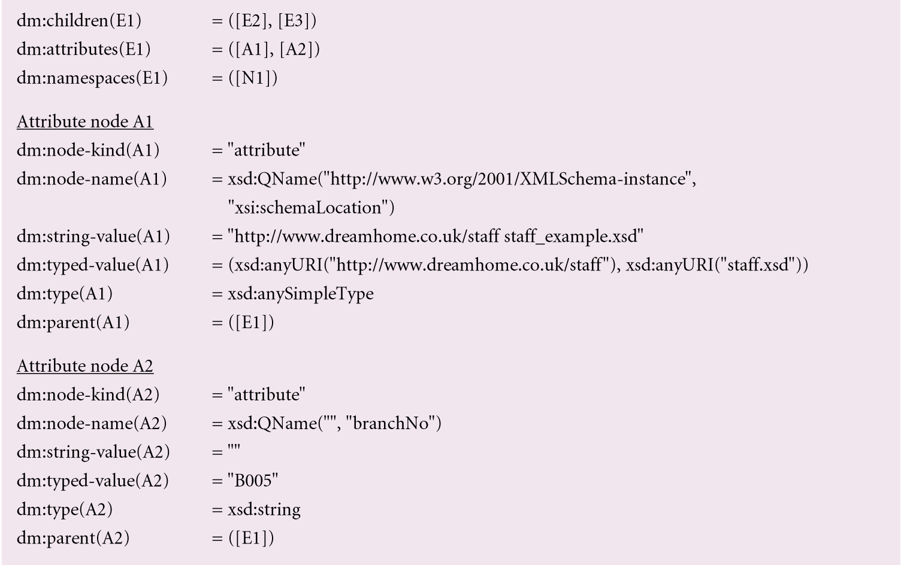
Example 30.8 - XML Query Data Model

Slide 99
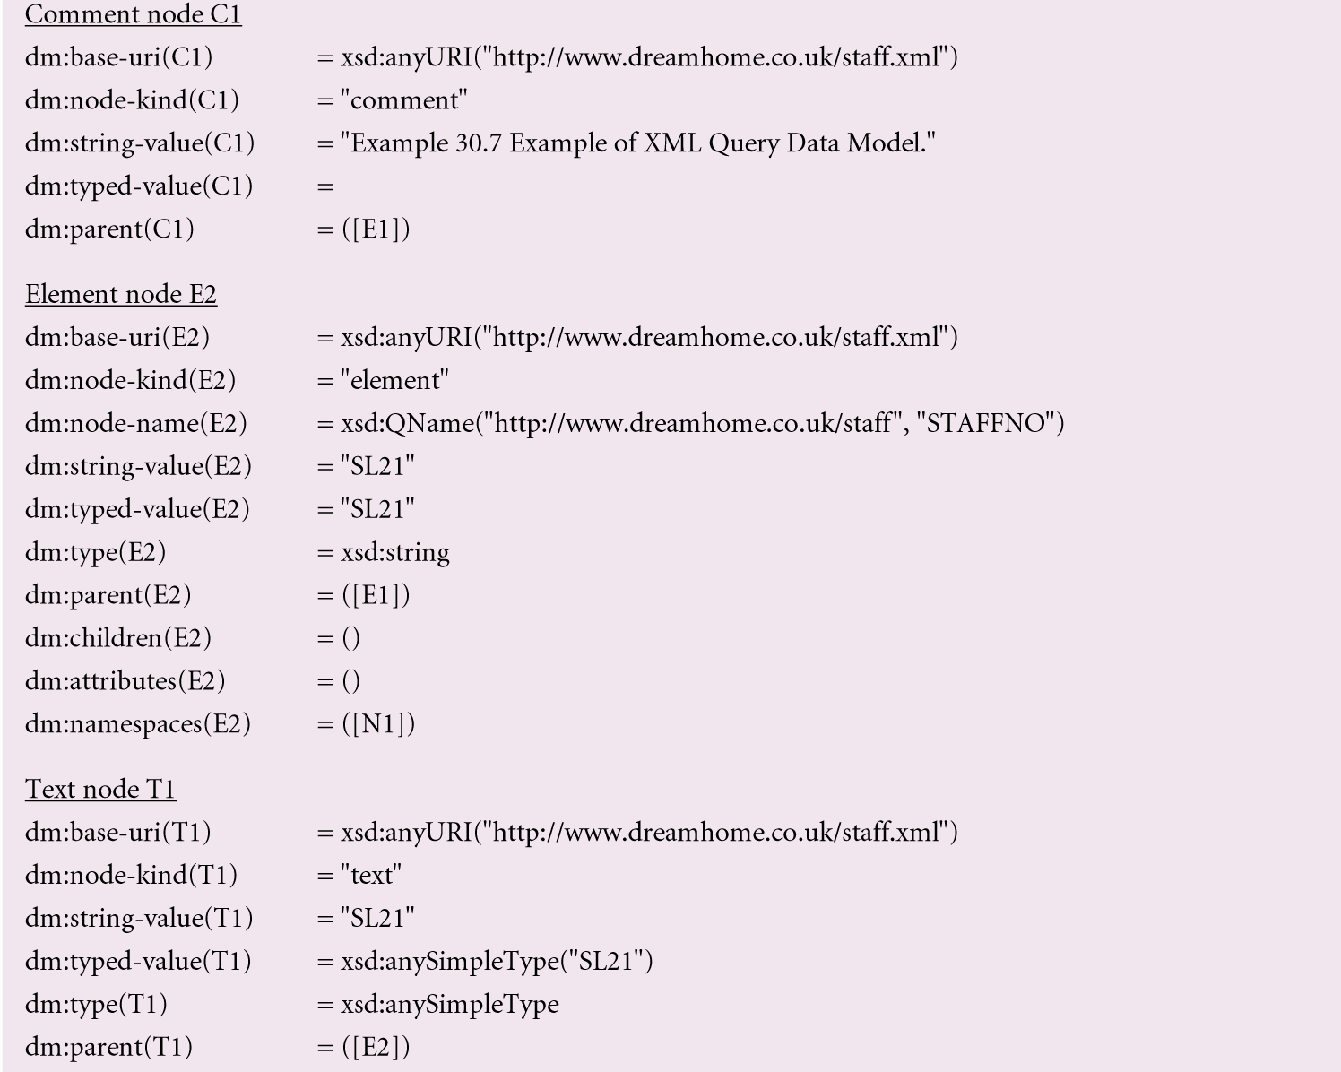
Example 30.8 - XML Query Data Model

Slide 100

www.healthytravelblog.com

